Slide 1
From bench to bedside
IDH-mutations as a model for precision pathology
    Maria E. Arcila MD
Memorial Sloan Kettering Cancer Center, New York, NY, USA

Slide 2
Disclosures
Not directly relevant to the content of this lecture
Company | Relationship(s)
Janssen Global Services, Bristol-Myers Squibb, AstraZeneca, Roche, Merck, Biocartis | Consulting

Slide 3


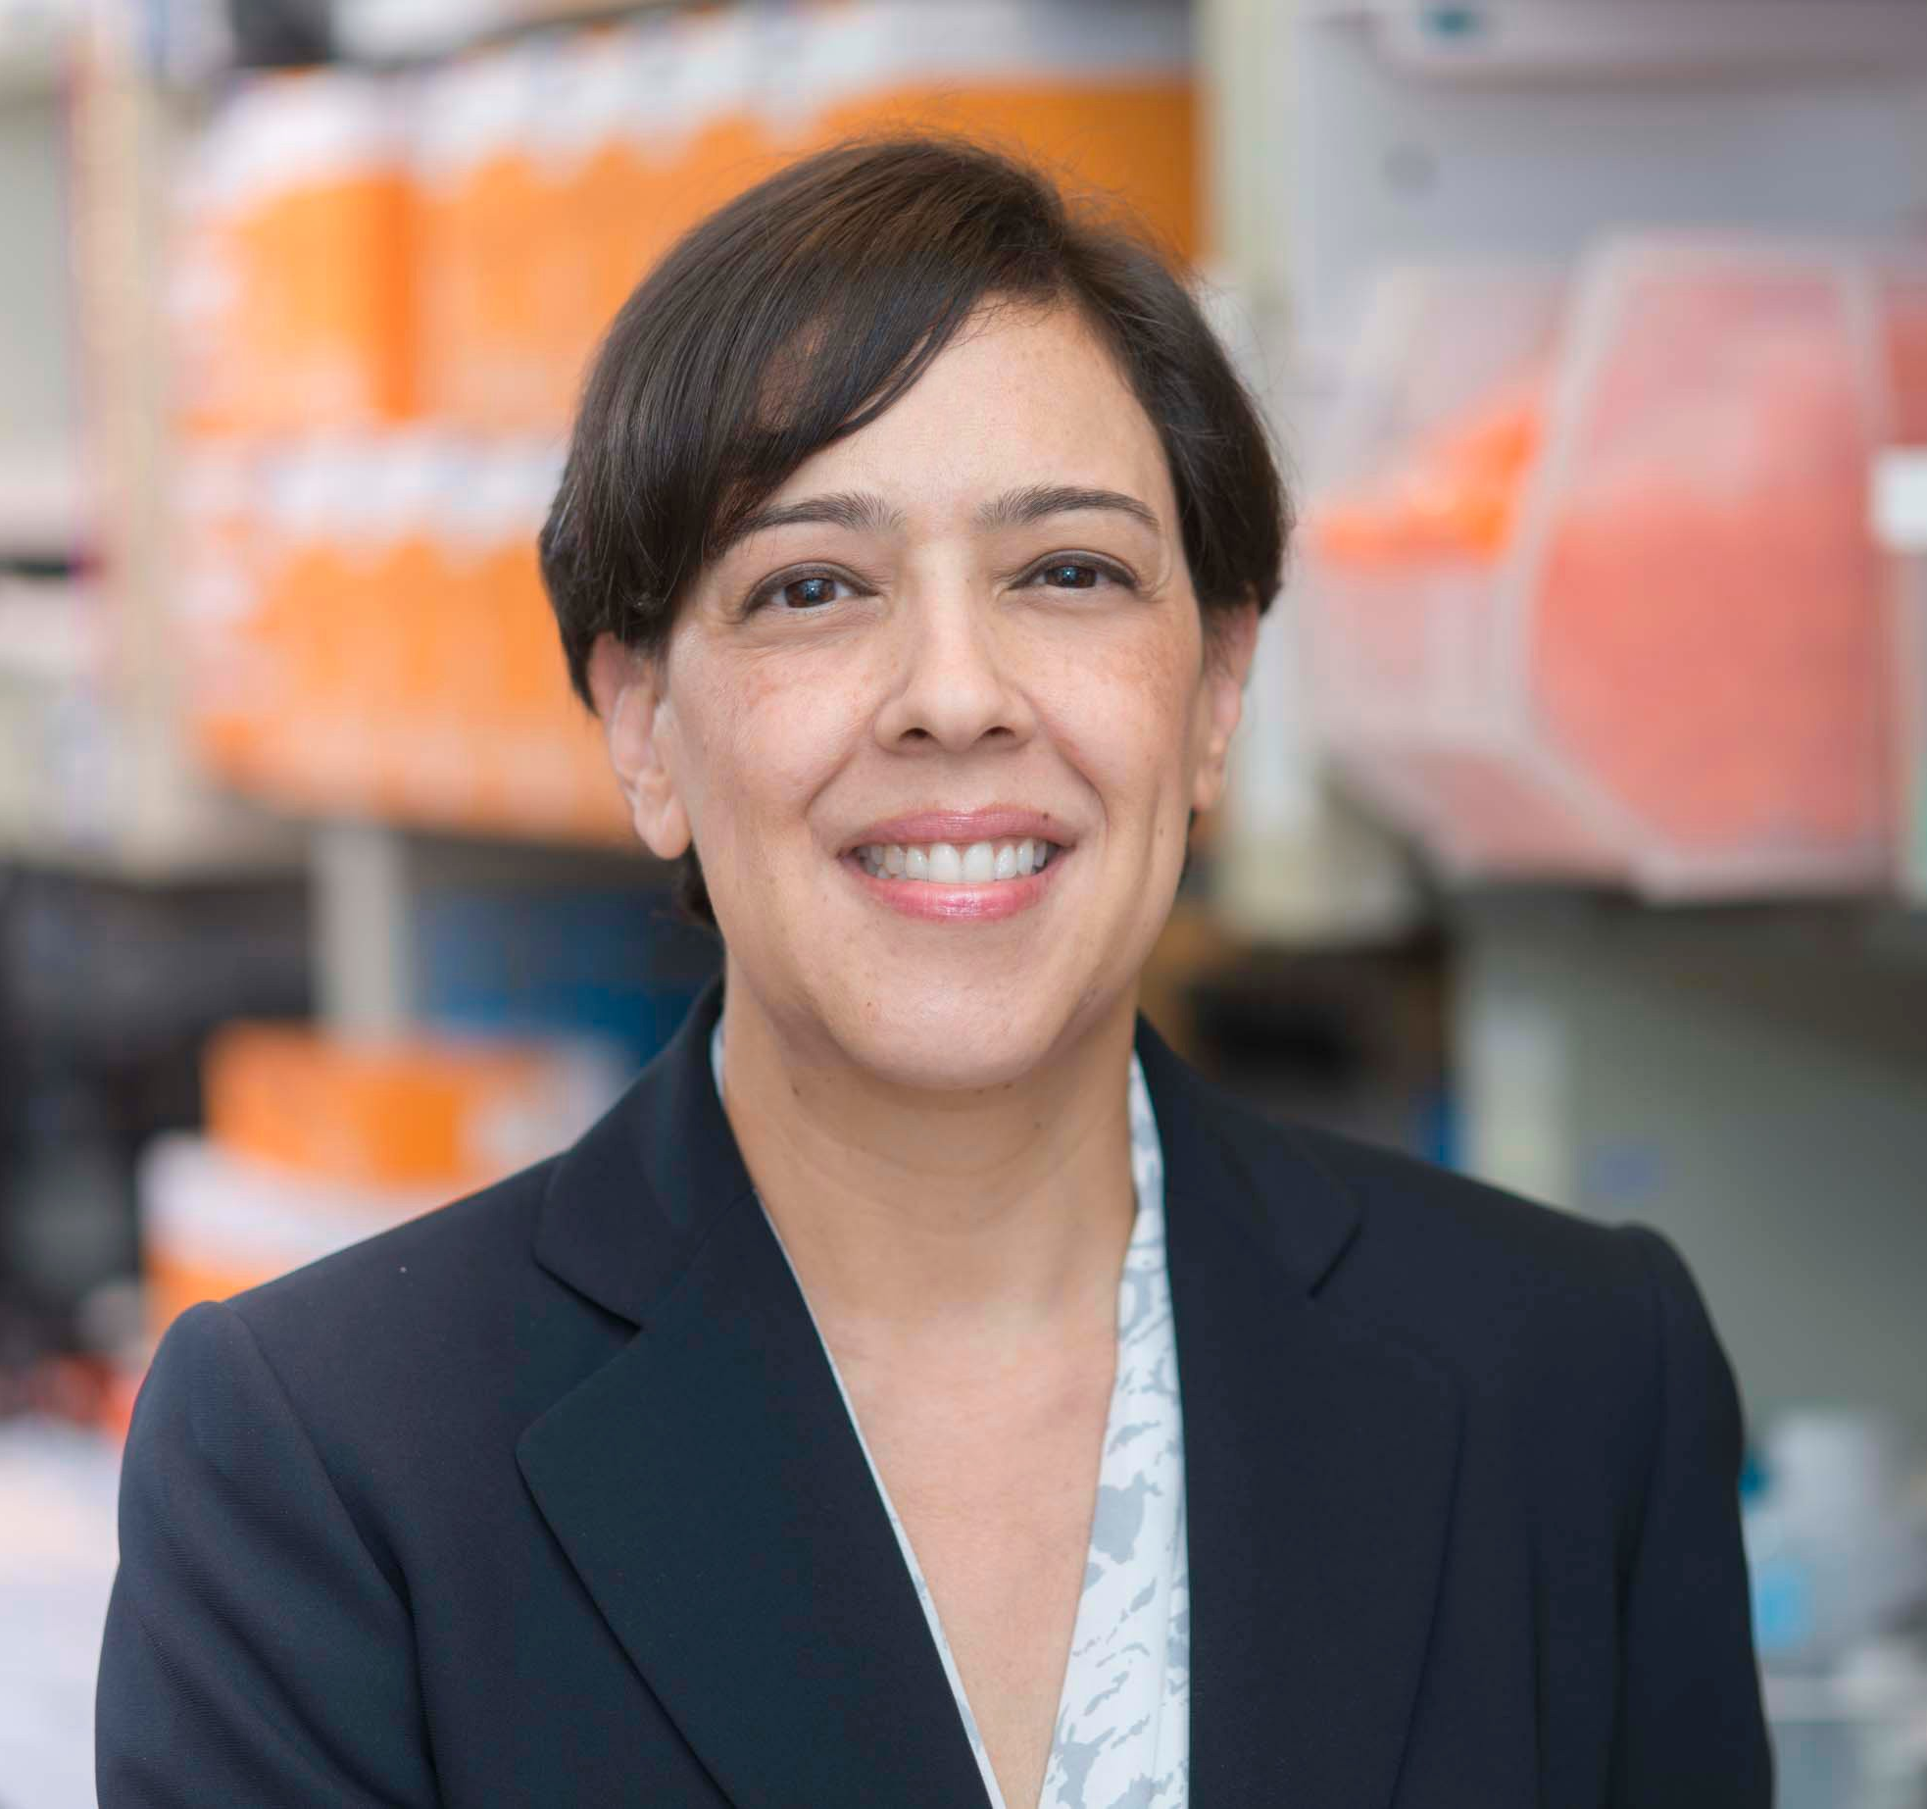

Maria E. Arcila, M.D.
Attending
Molecular Diagnostics and Hematopathology Services
Laboratory Director, Diagnostic Molecular Pathology
Department of Pathology and Laboratory Medicine
Memorial Sloan Kettering Cancer Center
You can find me at:
@MArcila

Slide 4
Objectives
Describe the role of Isocitrate dehydrogenase (IDH) in normal physiologic processes
Understand the role of IDH deregulation in human cancers using a case based approach
Review the role of targeted therapies and potential opportunities
Review the key testing strategies in solid tumors and hematologic malignancies

Slide 5

Mitochondrion
Cytoplasm
Nucleus
Isocitrate Dehydrogenase (IDH) Biology
Aberrant methylation
Chromatin restructuring
Differentiation blocks
Altered metabolism
Tumorigenesis
Citric acid
Isocitrate
Citric acid
Isocitrate
DNA and histone demethylation
IDH2
IDH1
Me
α-KG
α-KG
mIDH2
mIDH1
2-HG
2-HG
Me
Me
IDHs are
critical metabolic enzymes in the Krebs cycle
DNA and histone hypermethylation
*2HG = 2-hydroxyglutarate
Notes:
Isocitrate dehydrogenases are metabolic enzymes in the Krebs cycle responsible for the conversion of isocitrate to alpha ketoglutarate. IDH2 acts primarily in the mitochondrion while IDH1 lives in the cytoplasm. Alpha ketoglutarate, in turn plays a key role in regulated demethylation of DNA and histones for proper gene expression.
Mutations in isocitrate dehydrogenase (IDH) 1 and -2 increase the capacity of cancer cells to produce a normally scarce metabolite, D-2-hydroxyglutarate (2-HG), by several orders of magnitude. The discovery of the unusual biochemistry of IDH mutations spurred a flurry of activity that revealed 2-HG as an ‘oncometabolite’ with pleiotropic effects in malignant cells and consequences for anti-tumour immunity. 2-HG dysregulates a wide array of molecular pathways, among them a large family of dioxygenases that utilize the closely related metabolite α-ketoglutarate (α-KG) as an
Biochem Soc Trans. 2023 Aug 31; 51(4): 1675–1686.
Published online 2023 Aug 1. doi: 10.1042/BST20230017
PMCID: PMC10586776
PMID: 37526143
The curious case of IDH mutant acute myeloid leukaemia: biochemistry and therapeutic approaches
Emily Gruber and Lev M. Kats
essential co-substrate. 2-HG not only contributes to malignant transformation, but some cancer cells become addicted to it and sensitive to inhibitors that block its synthesis. Moreover, high 2-HG levels and loss of wild-type IDH1 or IDH2 activity gives rise to synthetic lethal vulnerabilities.

Slide 6
Key Biomarker Diagnostic, prognostic and therapeutic implications
Low grade glioma
Grade II-III astrocytoma
Oligodendroglioma
Grade IV glioblastoma
(up to 74%)
Sinonasal undifferentiated carcinoma (82%)
Thyroid carcinoma
Solid Papillary Carcinoma with reverse polarity (85%)
Cholangiocarcinoma
(24%)
Acute myeloid leukemia (up to 33%)
Myelodysplastic syndrome (up to 10%)
Angioimmunoblastic T cell lymphoma (30%)
Gian cell tumor of bone (80%) Chondrosarcoma (56% )

Slide 7
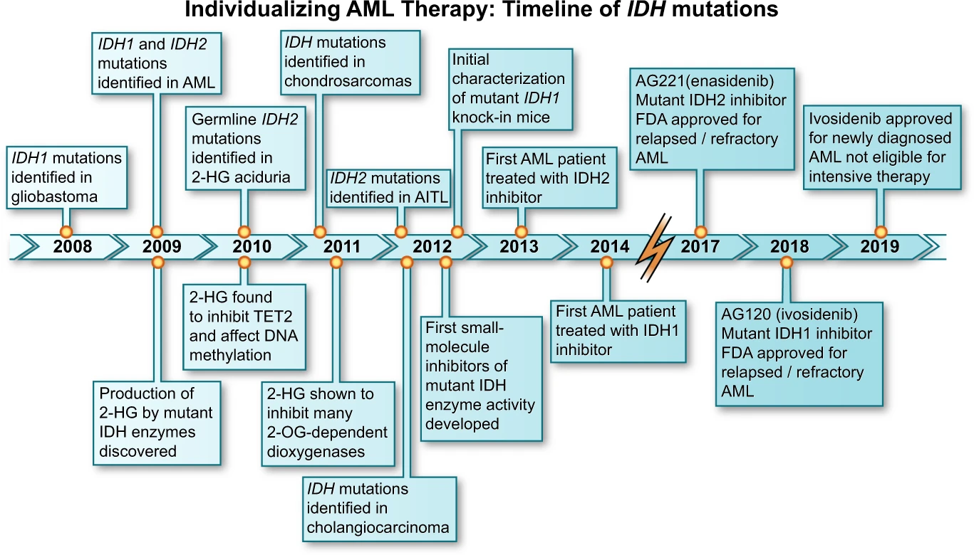
Timeline depicting the decade of progress in IDH-mutated malignancies
Blood Cancer Journal (Blood Cancer J.) ISSN 2044-5385 (online)

Slide 8
Case study #1
A 78-year-old male presents with weakness and a general lack of energy
CBC and peripheral blood smear show leukocytosis, thrombocytopenia and circulating myeloblasts at 33% of the WBC
Overall evaluation was consistent with acute myeloid leukemia
Notes:
Case study #1
A 78-year-old female presents to PCP with weakness and a general lack of energy
CBC and peripheral blood smear show leukocytosis, thrombocytopenia and circulating myeloblasts at 66% of the WBC
Overall evaluation was consistent with Acute myeloid leukemia
leukocytosis with circulating blasts
Complete blood cell count (CBC)

Slide 9
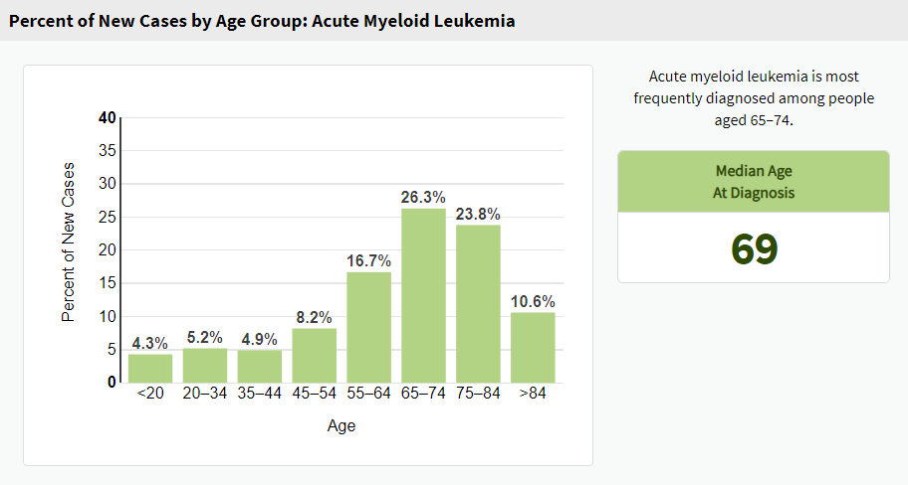
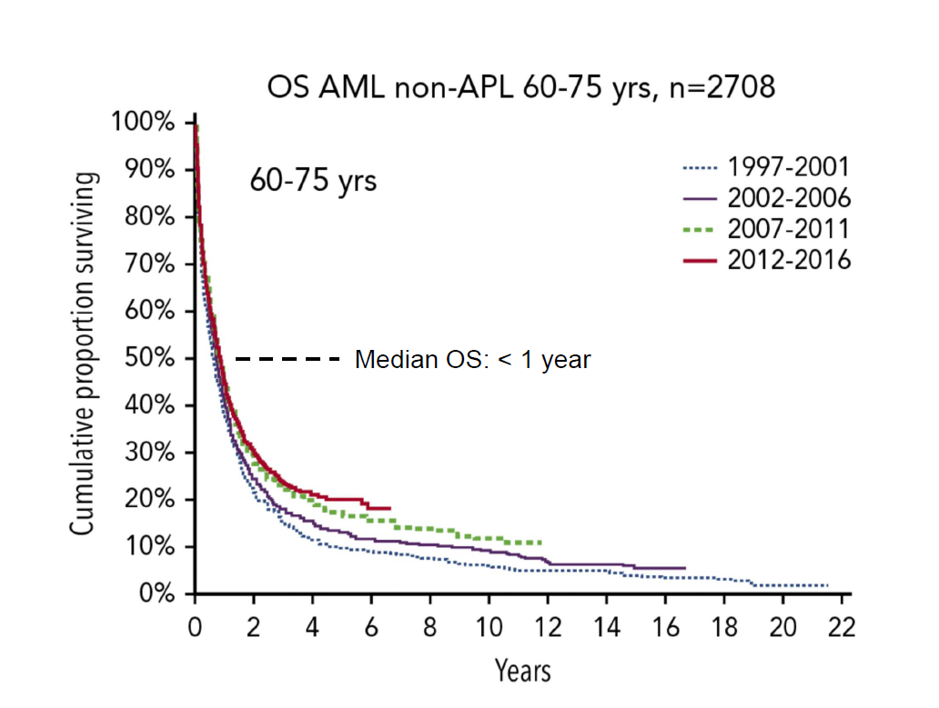
Acute myeloid leukemia - AML
Aggressive hematologic disease affecting primarily older adults
Poor overall survival in older patients treated with intensive chemotherapy
SEER 22 factsheet (2017–2021, All Races, Both Sexes)
Juliusson et. al. Blood 2019
https://doi.org/10.1182/blood.2019001728
Notes:
AML is an aggressive hematologic malignancy that affects primarily individuals in their 60’s - with a median age of diagnosis of 69. Across the board, the 5 year overall survival is 32% - in older adults is much lower – 5 year overall survival of 20% and median overall survival <1yr.
However, in the past few years we have seen an upward trend in survival due to improvements in therapeutic interventions, one of which is IDH inhibitors.
In concert with the sequencing of the first AML genome in 2008, the discovery of isocitrate dehydrogenase (IDH) mutations in AML was first described¹. It is now recognized that approximately 8% and 12% of acute myeloid leukemias harbor an IDH1 or IDH2 mutation, respectively, with IDH mutations also present in a minority of other myeloid malignancies such as myelodysplastic syndrome (MDS) and accelerated myeloproliferative neoplasms (MPNs)^{2,3}.
Mutations in IDH1 and IDH2 occur at conserved arginine residues within the enzymatic active site, specifically the R132 locus of IDH1, and the R140 or (less commonly) the R172 locus of IDH2⁴. These cancer-associated mutations cause a loss-of-function in the normal Kreb’s cycle reaction of isocitrate to alpha-ketoglutarate (aKG), and instead trigger a reverse reaction where aKG is reduced to 2-hydroxyglutarate (2-HG)^{5,6}. In this manner, 2HG functions as a cancer “oncometabolite”, competitively inhibiting aKG-dependent enzymes such as the TET family enzymes and lysine demethylases, and leading to a characteristic hypermethylated phenotype⁷. The pathophysiology stemming from aberrant 2HG production also occurs through abnormal H1F1a and induction of BCL2 dependence via inhibition of cytochrome C oxidase^{8,9}.
The impact of IDH mutations on AML prognosis remains somewhat controversial, although a generally inferior outcome is seen with IDH1 mutations and a relatively favorable prognosis may be seen with IDH2 mutations, particularly R172K IDH2 mutations, in the setting of standard intensive chemotherapy^{10,11,12,13,14,15,16,17}. IDH1 and IDH2 mutations are associated with certain patient and disease-specific characteristics; notably an older age at presentation, diploid or other intermediate-risk cytogenetics (i.e. trisomy 8), and a sustained platelet count at presentation. The impact of IDH1 and IDH2 mutations are also context dependent, with IDH mutations that occur in the setting of NPM1 mutations (without FLT3-ITD) appearing to confer more favorable outcomes¹².
The recent discovery of recurrent IDH mutations in cancer led to the rapid development of small molecule targeted inhibitors, which effectively inhibit the 2HG oncometabolite and promote the restoration of normal myeloid differentiation¹⁸. In less than 10 years from the original discovery of cancer-associated IDH1 and IDH2 mutations, first-in-class mutant IDH1 and IDH2 are now clinically available for patients with AML harboring these mutations. (Fig. 1)

Slide 10
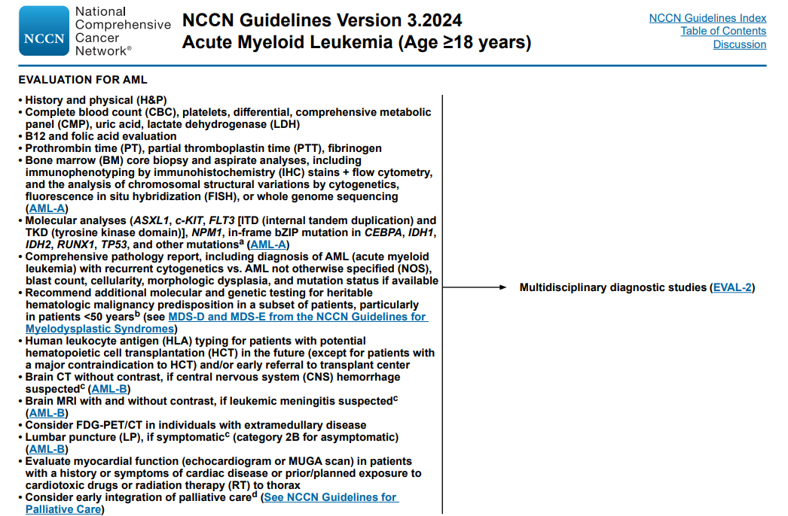
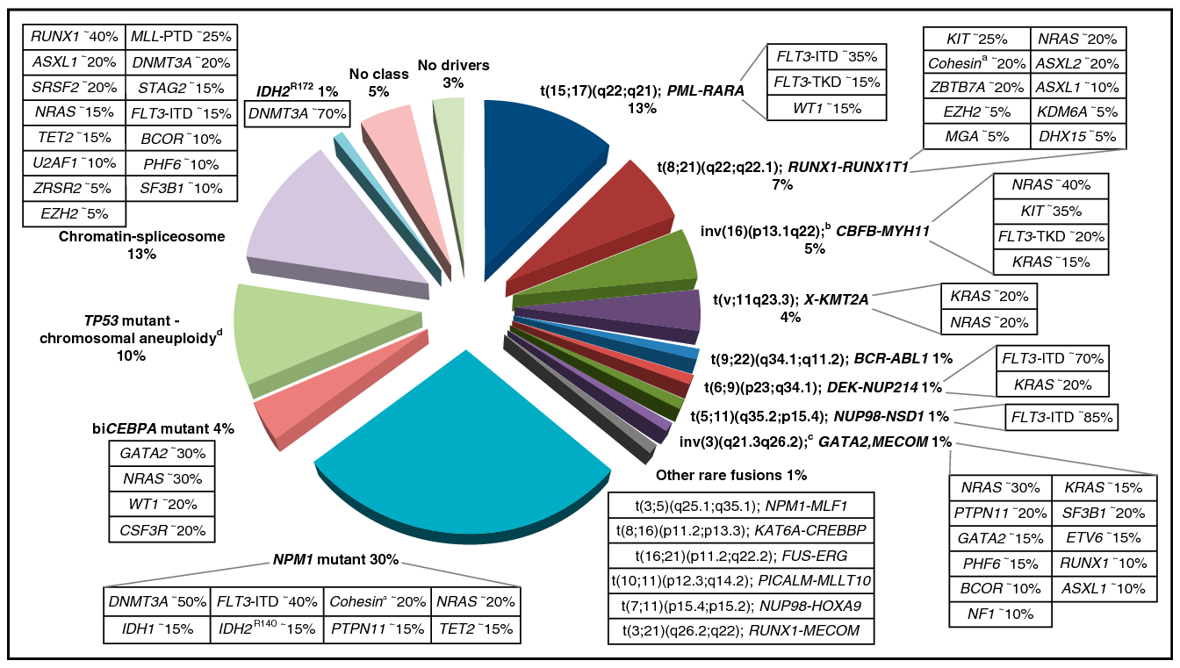
Testing for FLT3 and IDH1/2 should be resulted within 3-5 days

Slide 11
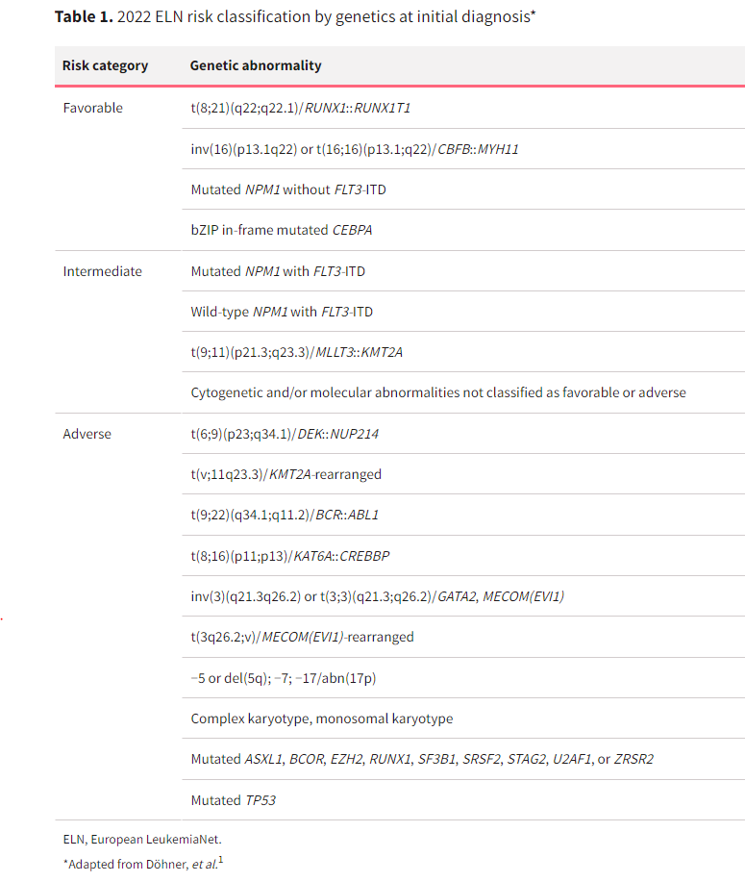
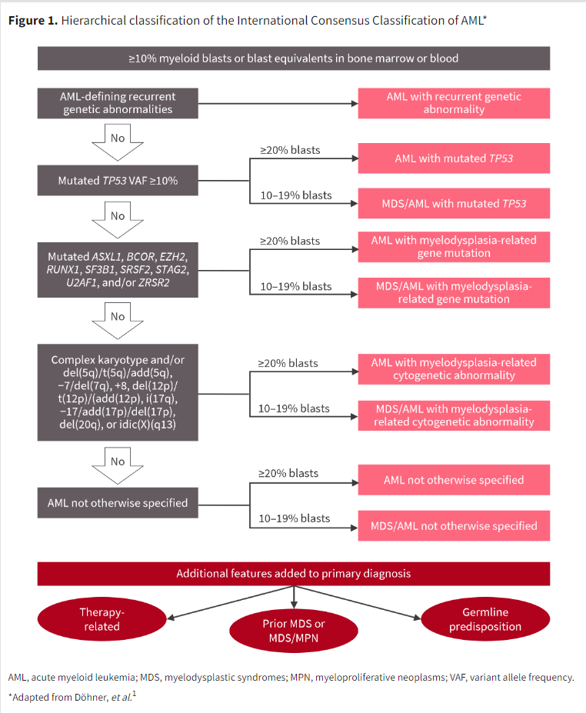
Genetic classification and risk stratification

Slide 12
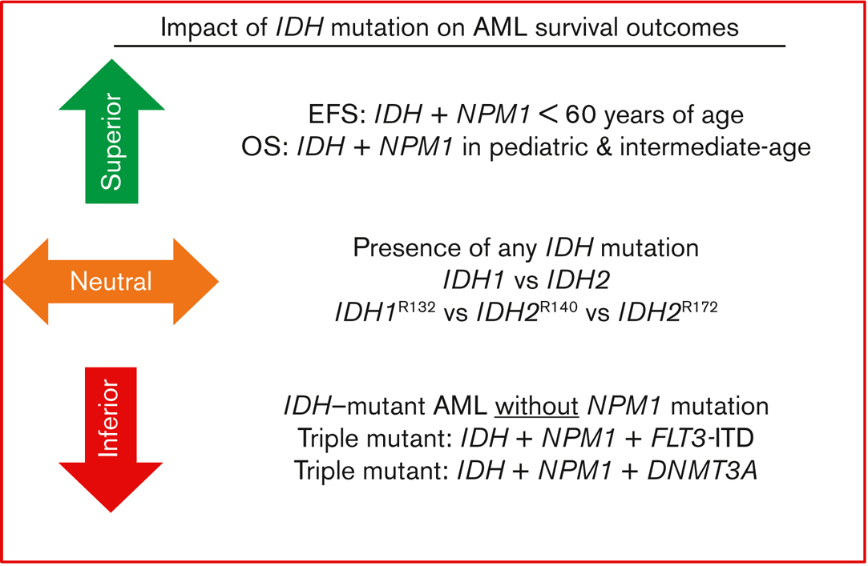
Prognostic value
Conflicting results have been reported
Some negative prognostic impact
others neutral, or favorable dependent upon co-occurring cytogenetic changes and gene mutations
Characteristics and prognostic impact of IDH mutations in AML: a COG, SWOG, and ECOG analysis, Blood Adv, 2023
Notes:
Mutations within the isocitrate dehydrogenase 1 or 2 genes (i.e., IDH1 or IDH2) occur in approximately 20% (IDH1: ~7–8%; IDH2: ~9–12%) of ND-AML [45,46,47]. Amino acid changes at the R132 residue in IDH1 or R140/R172 residue in IDH2 result in formation of neomorphic enzymatic activity and production of the oncometabolite 2-hydroxyglutarate (2-HG) [48,49]. Accumulation of 2-HG impairs alpha-ketoglutarate-dependent enzymes (including TET2) altering epigenetic regulation and cellular metabolism resulting in impaired cellular differentiation and proliferation- thereby promoting leukemogenesis [50,51,52]. IDH-mutated leukemia cells have an altered mitochondrial outer membrane permeability threshold, increasing their reliance on the antiapoptotic protein BCL2 for cell survival [53].
Conflicting results have been reported on the prognostic impact of IDH mutations in AML. Some analyses report a negative prognostic impact while others report a neutral, or favorable prognostic influence of IDH mutations dependent upon co-occurring cytogenetic changes and gene mutations [46,54,55,56,57]. As with FLT3i, the development of IDH inhibitors (IDHi) resulted in targeted therapy for a molecularly defined subgroup of AML. Currently, three IDHi are approved for the treatment of IDH1 or IDH2-mutated AML. Prospective studies of IDH inhibitors are displayed in Table 2.

Slide 13
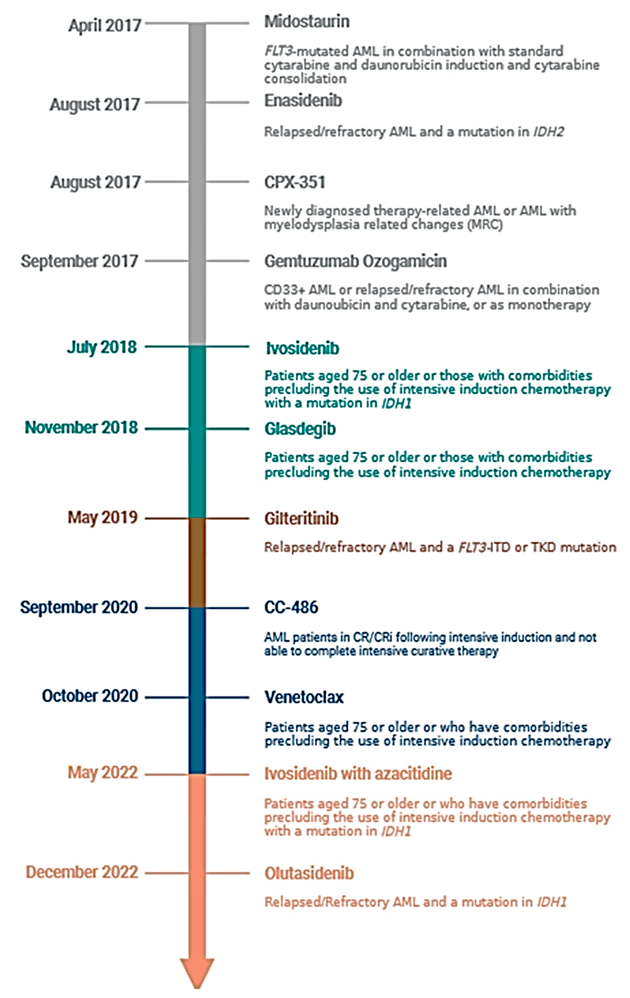
Therapeutic value
IDH positive mutation status defines a molecular subgroup of AML amenable to treatment with approved inhibitors
Three IDHi approved for AML
Molecularly Targeted Therapy in Acute Myeloid Leukemia: Current Treatment Landscape and Mechanisms of Response and Resistance
March 2023 Cancers·15(5):1617

Slide 14
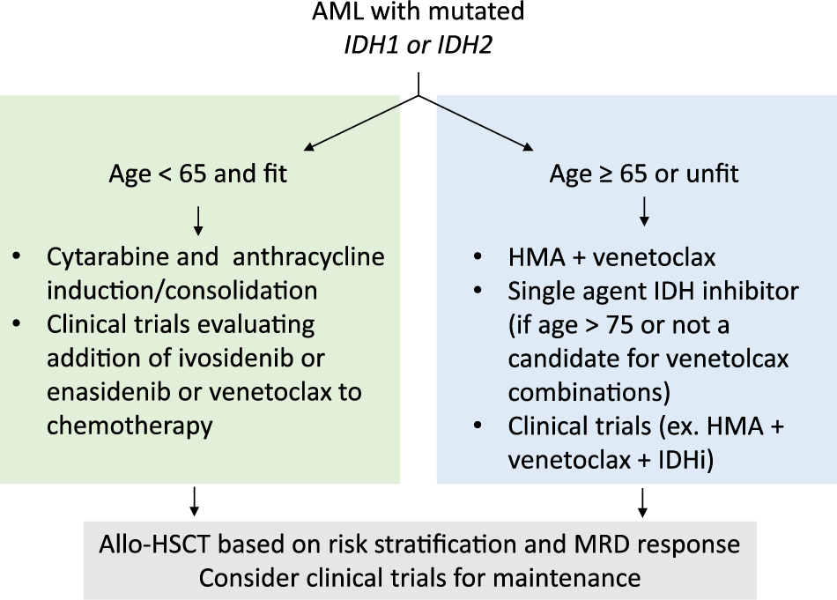
Clinical Management:
Define induction strategy
Younger - Intensive standard induction
Older - Less intensive
Risk stratify to determine transplant status
Transplant for intermediate to high risk
Low risk allows delays in using transplant
Targeted therapies

Slide 15
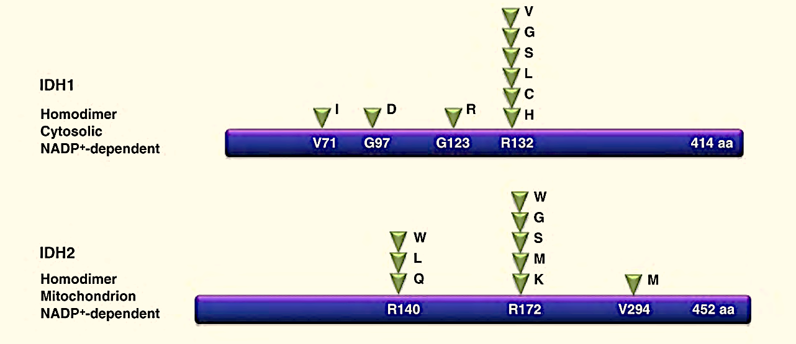
IDH mutations in AML
Hotspots
IDH1 R132
IDH2 R140 and R172
Overall incidence in newly diagnosed AML ~20%
7-8%
9-12%
Notes:
Mutations within the isocitrate dehydrogenase 1 or 2 genes (i.e., IDH1 or IDH2) occur in approximately 20% (IDH1: ~7–8%; IDH2: ~9–12%) of ND-AML [45,46,47]. Amino acid changes at the R132 residue in IDH1 or R140/R172 residue in IDH2 result in formation of neomorphic enzymatic activity and production of the oncometabolite 2-hydroxyglutarate (2-HG) [48,49]. Accumulation of 2-HG impairs alpha-ketoglutarate-dependent enzymes (including TET2) altering epigenetic regulation and cellular metabolism resulting in impaired cellular differentiation and proliferation- thereby promoting leukemogenesis [50,51,52]. IDH-mutated leukemia cells have an altered mitochondrial outer membrane permeability threshold, increasing their reliance on the antiapoptotic protein BCL2 for cell survival [53].
Conflicting results have been reported on the prognostic impact of IDH mutations in AML. Some analyses report a negative prognostic impact while others report a neutral, or favorable prognostic influence of IDH mutations dependent upon co-occurring cytogenetic changes and gene mutations [46,54,55,56,57]. As with FLT3i, the development of IDH inhibitors (IDHi) resulted in targeted therapy for a molecularly defined subgroup of AML. Currently, three IDHi are approved for the treatment of IDH1 or IDH2-mutated AML. Prospective studies of IDH inhibitors are displayed in Table 2.

Slide 16
All newly diagnosed AML at MSKCC
Reflex
Rapid single gene testing by Idylla and Frag analysis
(IDH and FLT3)
AML
MSK-fusion
NGS panel 200 genes
(RNASeq – Anchored PCR and NGS)
MSK- IMPACT
Heme
(NGS panel 468 genes)

Slide 17
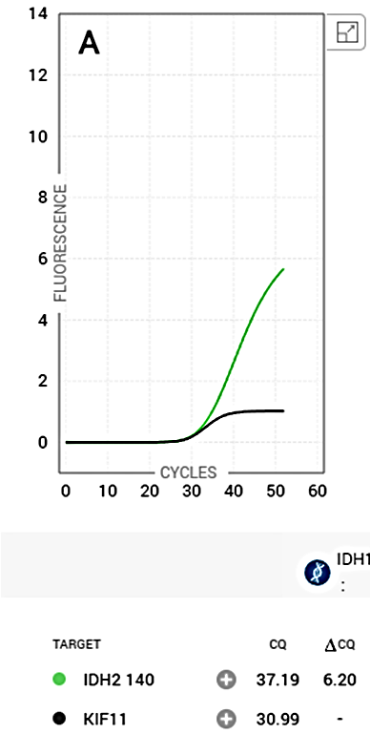
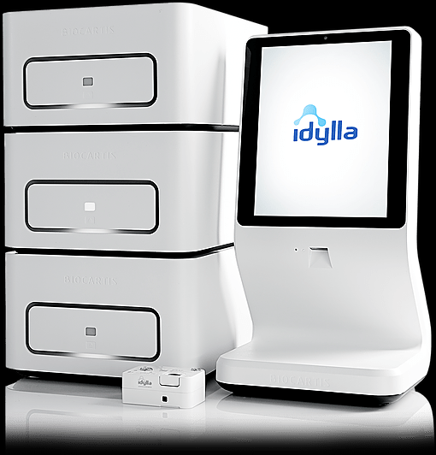
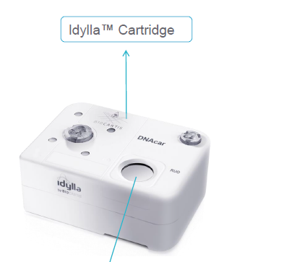
Rapid IDH 1 / 2 screening (no extraction)
Specimen | Input Quantity
Direct Bone marrow aspirate and peripheral blood (PB) | 5-10uL
5μm FFPE tissue sections (10% neoplastic cells) | 1 slide (min 9mm²)
Extracted DNA* or pre-capture libraries from MSK IMPACT | 100ng
Key parameters
CQ – CT or cycle threshold
Delta CQ: difference between control and mutation
Sample processing: liquefaction, cell lysis, extraction
Amplification and detection
Data Analysis
Results within 2 hrs
IDH2 R140Q Mutation
Sample Processing Control (SPC, KIF11)
Notes:
The KRAS assay for tissue in the Idylla platform is our rapid method for assessment of common mutations in this gene and is meant for use on tumor tissue. There is a separate assay for assessment of cell free DNA from plasma. The benefit of this assay is the fact that DNA extraction is not required and the assay may be performed directly form sections of FFPE, cytologic material in cytolyte or fixed in alcohol but may also be performed on extracted DNA and aliquots form precapture libraries from IMPACT. As such, there is significant flexibility to perform the assay.
The Idylla System consists of a Console which is connected to one or more instrument modules. Idylla Cartridges are created for single sample use only and are set as a closed system to minimize contamination. Within the cartridge, separate compartments allow for central sample processing into a lysate which is then distributed to other compartments for PCR amplification. Results are analyzed on the Idylla Biocartis system using test specific software packages (Test Type Packages, TTP). Altogether, the process takes less than 2 hrs to complete. The cartridge incorporates testing of 21 variants in exon 2, 3 and 4 of KRAS and also amplifies WT KRAS which is utilized as an internal sample processing control.

Slide 18
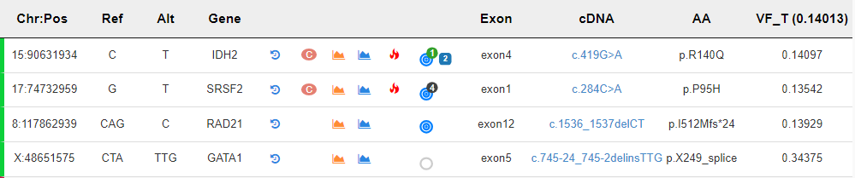
NGS testing
Absent TET mutations

Slide 19
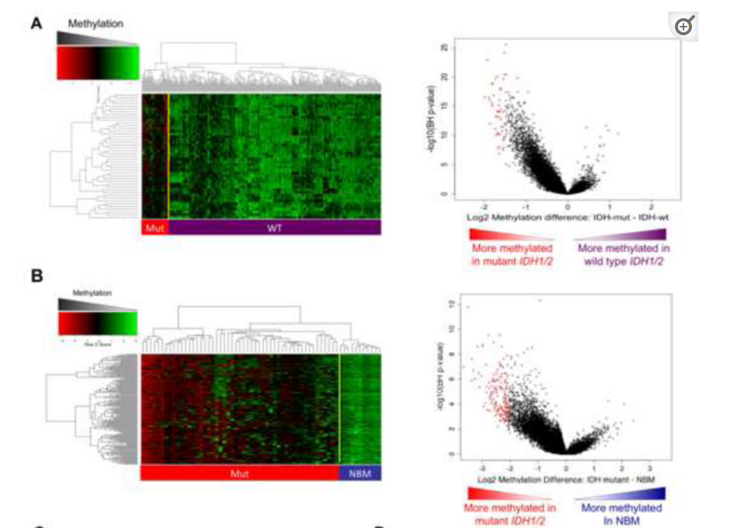
Key features of IDH1/2 mutated AML
Mutated vs WT
Display global DNA hypermethylation and a specific hypermethylation signature.
IDH1 and IDH2 mutations display similar DNA methylation profiles
Mutated vs normal marrow
Notes:
Cancer-associated IDH mutations are characterized by neomorphic enzyme activity and resultant 2 hydroxyglutarate (2HG) production. Mutational and epigenetic profiling of a large AML patient cohort revealed that IDH1/2-mutant AMLs display global DNA hypermethylation and a specific hypermethylation signature. Furthermore, expression of 2HG-producing IDH alleles in cells induced global DNA hypermethylation. In the AML cohort, IDH1/2 mutations were mutually exclusive with mutations in the α-ketoglutarate-dependent enzyme TET2, and TET2 loss-of-function mutations associated with similar epigenetic defects as IDH1/2 mutants. Consistent with these genetic and epigenetic data, expression of IDH mutants impaired TET2 catalytic function in cells. Finally, either expression of mutant IDH1/2 or Tet2 depletion impaired hematopoietic differentiation and increased stem/progenitor cell marker expression, suggesting a shared proleukemogenic effect.
1. supervised analysis comparing IDH1/2 wild-type vs. IDH1/2 mutant AMLs. Using stringent criteria (absolute log2 difference in methylation > 1.5, p<0.05 T-test with Benjamini-Hochberg correction for multiple testing (T+BH)) we identified 45 differentially methylated regions (DMRs), all of which were universally hypermethylated in IDH1/2 mutant AMLs (Figure 2A, and Table S1A).
2. specific epigenetic alterations associated with IDH1/2 mutant malignant transformation - supervised analysis of HELP profiles between a cohort of normal CD34+ cells obtained from the bone marrows of 11 healthy individuals (NBM) and the 51 IDH1/2-mutant AML. - a marked increase in DNA methylation levels in IDH1/2-mutant AMLs, as evidenced by the asymmetry of the dot plot of overall methylation levels (Figure 2B)

Slide 20
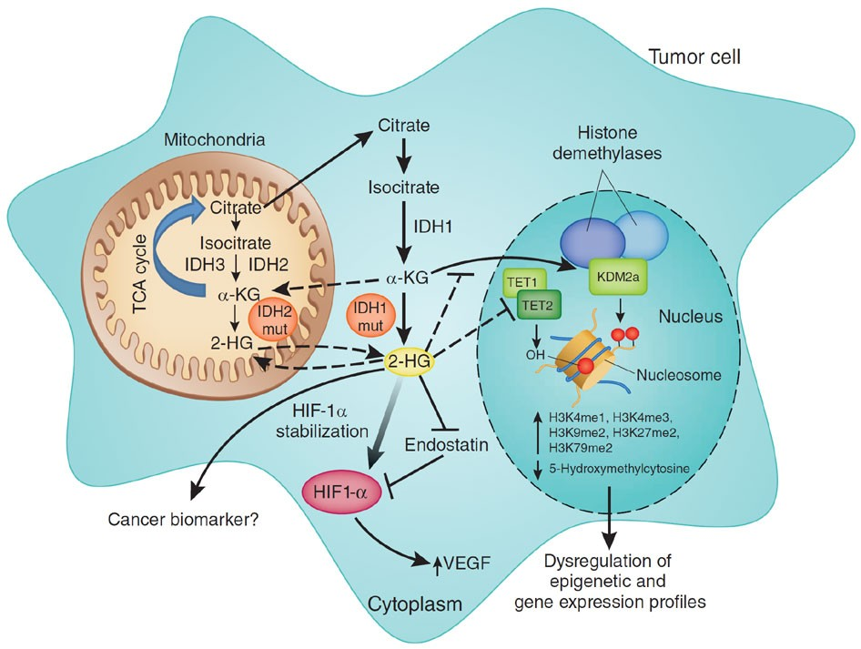
IDH1/2 and TE2 mutations are mutually exclusive in AML
TET2 is a Fe(II) and αKG-dependent enzyme
Critical regulator of DNA methylation (histone demethylating enzyme)
Loss of function mutations in AML and other myeloid malignancies leads to hypermethylated state similar to IDH1/2 mutations
Expression of mutant IDH proteins disrupt TET2 to block demethylation capabilities
Metabolism unhinged: IDH mutations in cancer
Nature Medicine volume 17, pages291–293 (2011)

Slide 21
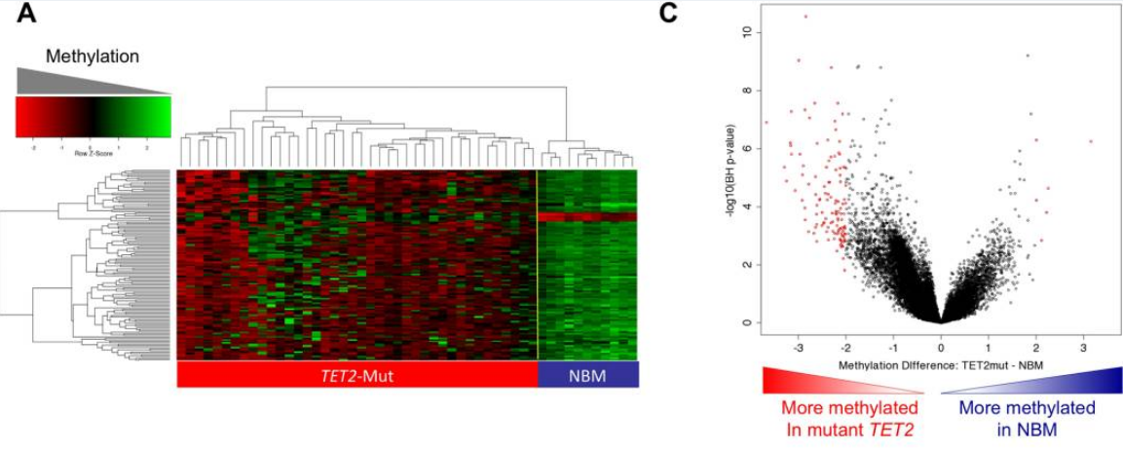
IDH1/2 and TET2 mutations are mutually exclusive in large, genetically annotated de novo AML cohort
Genetic alterations are biologically redundant –
May constitute distinct mutational classes in AML affecting epigenetic state
Notes:
We observed that IDH1/2 and TET2 mutations were mutually exclusive in a large, genetically annotated de novo AML cohort, suggesting that these lesions may be biologically redundant. TET2 is a member of a family of α KG-dependent enzymes that catalyze cytosine 5-hydroxymethylation and induce subsequent demethylation of DNA (Ito et al., 2010; Tahiliani et al., 2009). TET2 loss of function would be anticipated to result in hypermethylation, and the data reported here support that. Furthermore, IDH1/2 mutations, which lead to elevated levels of 2HG, an αKG analogue, might be anticipated to inhibit the function of TET2. In support of this possibility we observed that TET2 and IDH1/2 mutant AMLs presented with more pronounced hypermethylation profiles than other AMLs and shared an overlapping epigenetic signature. Most importantly, expression of IDH 1/2 mutants induced an increase in global DNA hypermethylation, and inhibited TET2 induced cytosine 5-hydroxymethylation. These data suggest that TET2 and IDH1/2 mutations constitute a distinct mutational class in AML, which affects the epigenetic state; we would predict that additional mutations will be identified which will be classified into this “epigenetic regulator” mutational class in AML and in other malignancies.

Slide 22
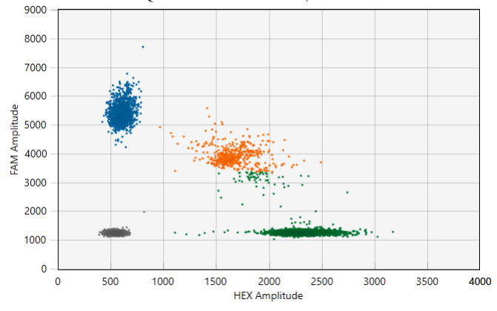
Patient follow up
Persistent AML
4% blast by aspirate
4.64% by flow
Received targeted therapy with enasidenib
Complicated by development of fever and pulmonary infiltrates
Testing performed with mutation specific digital PCR for monitoring of the R140Q mutation
POSITIVE for IDH2 R140Q mutation
The level of positivity 23.31%.

Slide 23
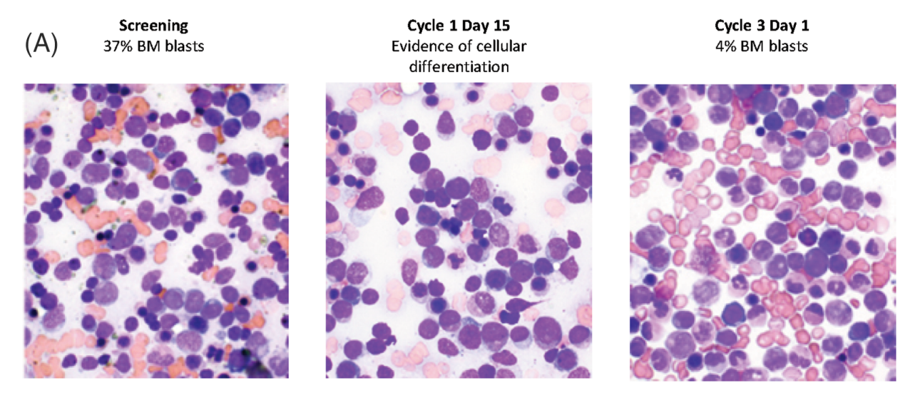
IDH differentiation syndrome
Successful suppression of aberrant 2HG production
Leads to reversal of the hypermethylation phenotype and release of the block on differentiation
Am J Hematol. 2021;96:735–746

Slide 24
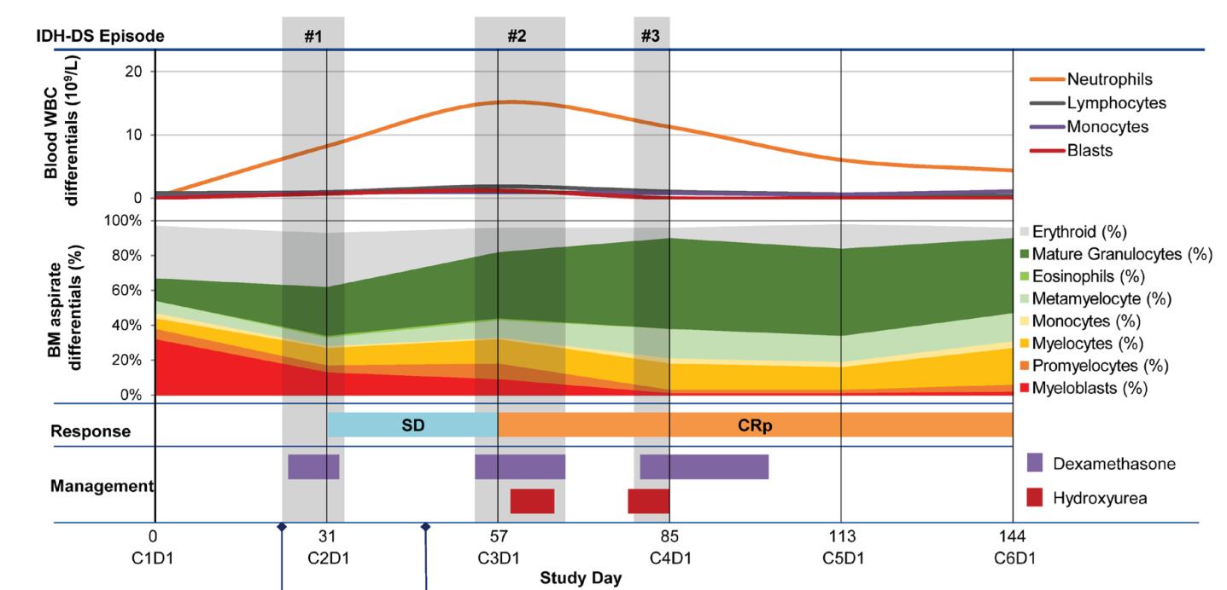
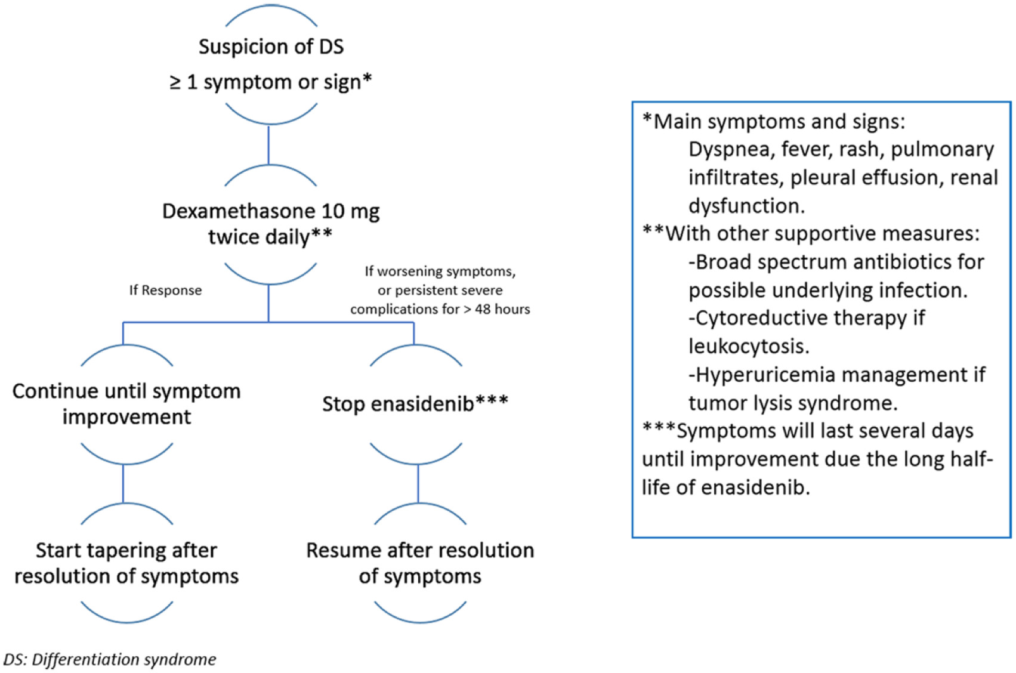
Am J Hematol. 2021;96:735–746
Therapeutic Advances in Hematology, Volume 9, Issue 7, July 2018, Pages 163-173

Slide 25
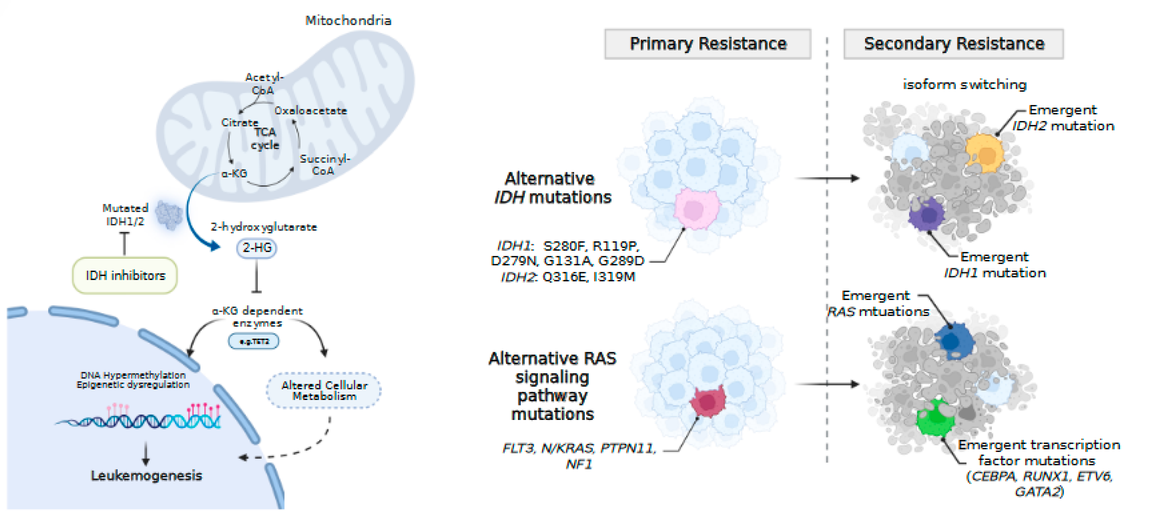
Resistance mechanisms
Molecularly Targeted Therapy in Acute Myeloid Leukemia: Current Treatment Landscape and Mechanisms of Response and Resistance
March 2023 Cancers·15(5):1617
Notes:
Several mechanisms of resistance to single-agent IDHi have been described Figure 2 [66,67,68,69]. IDH intrinsic mechanisms of resistance include second-site mutations in IDH1 or IDH2 [69]. IDH2 mutations Q316E and I319M within exon 7 have been identified in patients with progressive AML following treatment with ENA [69]. Notably, these mutations occurred in trans (i.e., on the opposite allele) to the originally identified R140Q mutations and at the region of interface with ENA [69]. A similar phenomenon was reported in a patient with IDH1-mutated AML treated with IVO, where a second-site mutation in IDH1 (S280F) was identified in cis, conferring IVO resistance [69]. Other described second-site IDH1 mutations include R119P, D279N, G131A, and G289D with indirect effects outside the IVO or NADPH binding pockets, and H315D with direct effects on the IVO or NADPH binding pockets [66].
Outgrowth of leukemic clones containing alternative mutant IDH isoforms (i.e., emergence or expansion of an IDH2-mutated leukemic clone in the setting of IDH1 inhibitor treatment) also drive resistance to monotherapy [66,67]. In patients treated with IVO, selective outgrowth of IDH2 R140Q and IDH2 R172W clones correlated with relapse and subsequent increases in 2-HG [67,68]. Outgrowth of IDH1 R132C containing clones conferring resistance to ENA therapy was observed in a patient with relapsed IDH2-mutated AML [67]. Single-cell DNA sequencing in patients treated with IVO confirmed IDH2-mutated clones can emerge independent of IDH1 mutation or as resistant subclones following IDHi therapy [66].
IDH extrinsic molecular mechanisms of relapse to IDHi therapy include mutations within active signaling and transcription factor mutations [66,68,70]. The presence of mutations in active signaling pathway genes (i.e., N/KRAS, PTPN11, FLT3-ITD/TKD, or KIT) corresponded to a lower CR/CRi (7% vs. 43%) following IVO monotherapy [66]. Similar resistance mechanisms were observed with ENA, where mutations in NRAS, PTPN11, and FLT3 were enriched in non-responding patients [68,70]. Mutations in myeloid transcription factors (CEBPA, RUNX1, GATA2) also correlated with lack of response to IDHi monotherapy [68]. Acquired mutations in either active signaling or myeloid transcription factor genes were frequently identified at the time of relapse to IVO or ENA [66,68,70] with resultant recapitulation of arrested differentiation of myeloid progenitors [70]. Indeed, leukemic stemness and a hypermethylated phenotype (devoid of mutations in DNMT3A) correlated with IDHi resistance [68]. Whether combining IDHi with other targeted or cytotoxic therapies can overcome these described resistance mechanisms observed with IDHi monotherapy and improve outcomes is an area of active investigation [59,71]. Preliminary data suggests upregulation of alternative anti-apoptotic proteins other than BCL-2 (i.e., MCL-1, BCL-xL) may promote resistance in patients treated with the combination of VEN and IVO [71].

Slide 26
Optimizing technology
Targeted non NGS
qPCR
Digital PCR
For rapid screening and / or high sensitivity monitoring
Targeted NGS
- Amplicon based
- Hybrid capture
For broad genomic characterization and detection of several resistance mechanisms
Comprehensive
NGS
- Whole exome
- Whole genome
For discovery – new markers, new resistance mechanisms
Infrastructure
Turnaround time
Sensitivity
(single target)
Notes:
We then moved to optimizing the technology to allow utilization of the fluids for testing with several technologies. In the clinical laboratory, we concentrated initially in an intermediate technology using hybrid capture

Slide 27
Adjust testing strategies to provide adequate care accordingly
Assay type | Examples | Application | Turn around time
Screening assay – targeted | qPCR, digital PCR | Rapid screening at time of diagnosis | 3-5 days
High sensitivity assay | qPCR, digital PCR | Monitoring of disease response, assessment of residual disease, monitoring for recurrence | 1 week
Comprehensive NGS | Amplicon or hybrid capture | Detection of IDH mutations and other biomarkers at diagnosis, broad assessment for potential resistance mechanisms | 1-2 weeks

Slide 28

IDH mutations in Gliomas
One of the key genetic events in gliomas
Form the basis of the classification of diffuse adult-type gliomas in the WHO classification of brain tumors
Emerging therapeutic implications

Slide 29
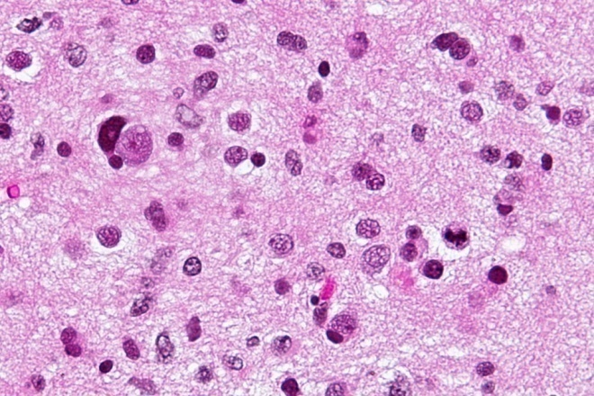
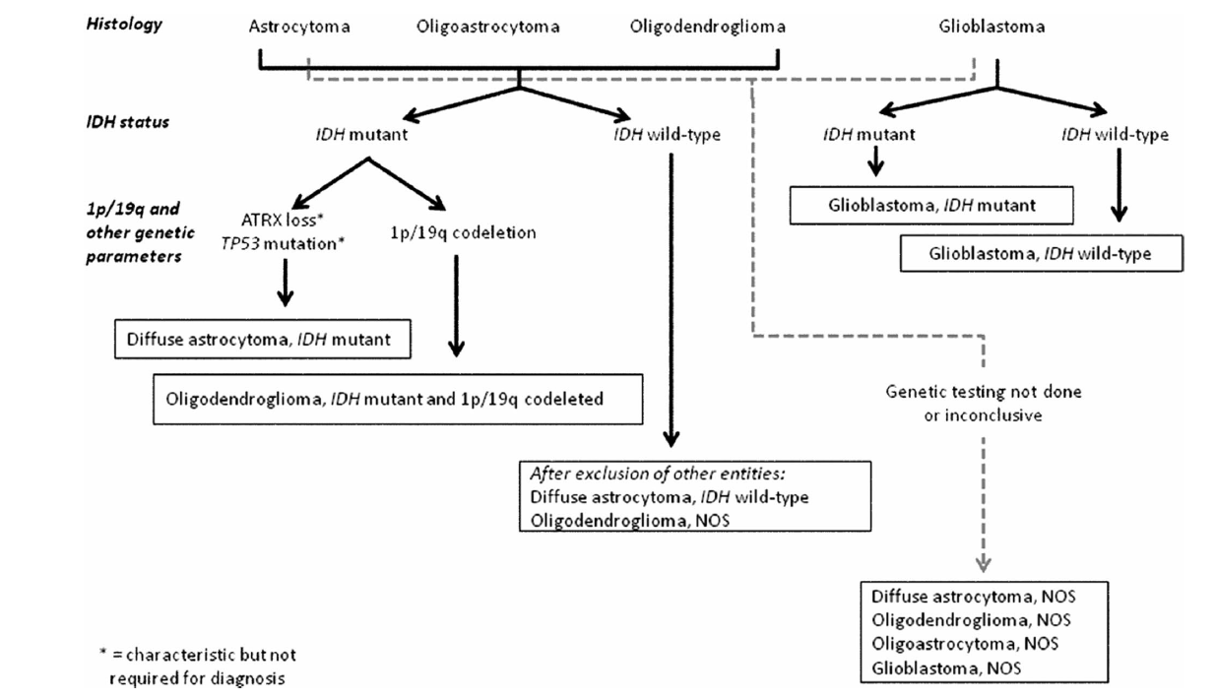
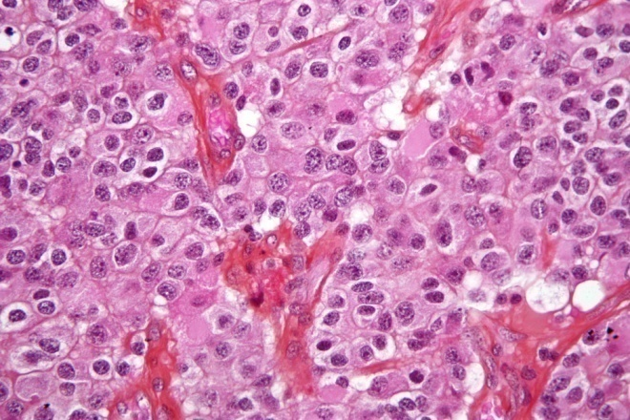
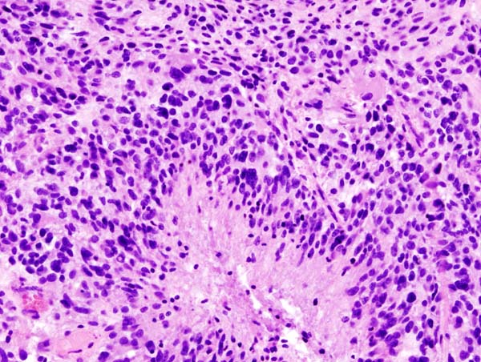
2016 WHO embraced new nomenclature:
Phenotype + Genotype = Integrated diagnosis
Acta Neuropathol. 2007 Aug; 114(2): 97–109
Notes:
The WHO classification of CNS tumors is the most widely accepted system for classifying CNS tumors, now into its 5th edition, traditionally published in a blue cover (thus "blue book").
Although traditionally based on histological characteristics of the tumors, since the 2016 revised 4th edition of the 'blue book' the classification increasingly relies on molecular parameters for classification and in some instances has elevated them above histological features ³.

Slide 30
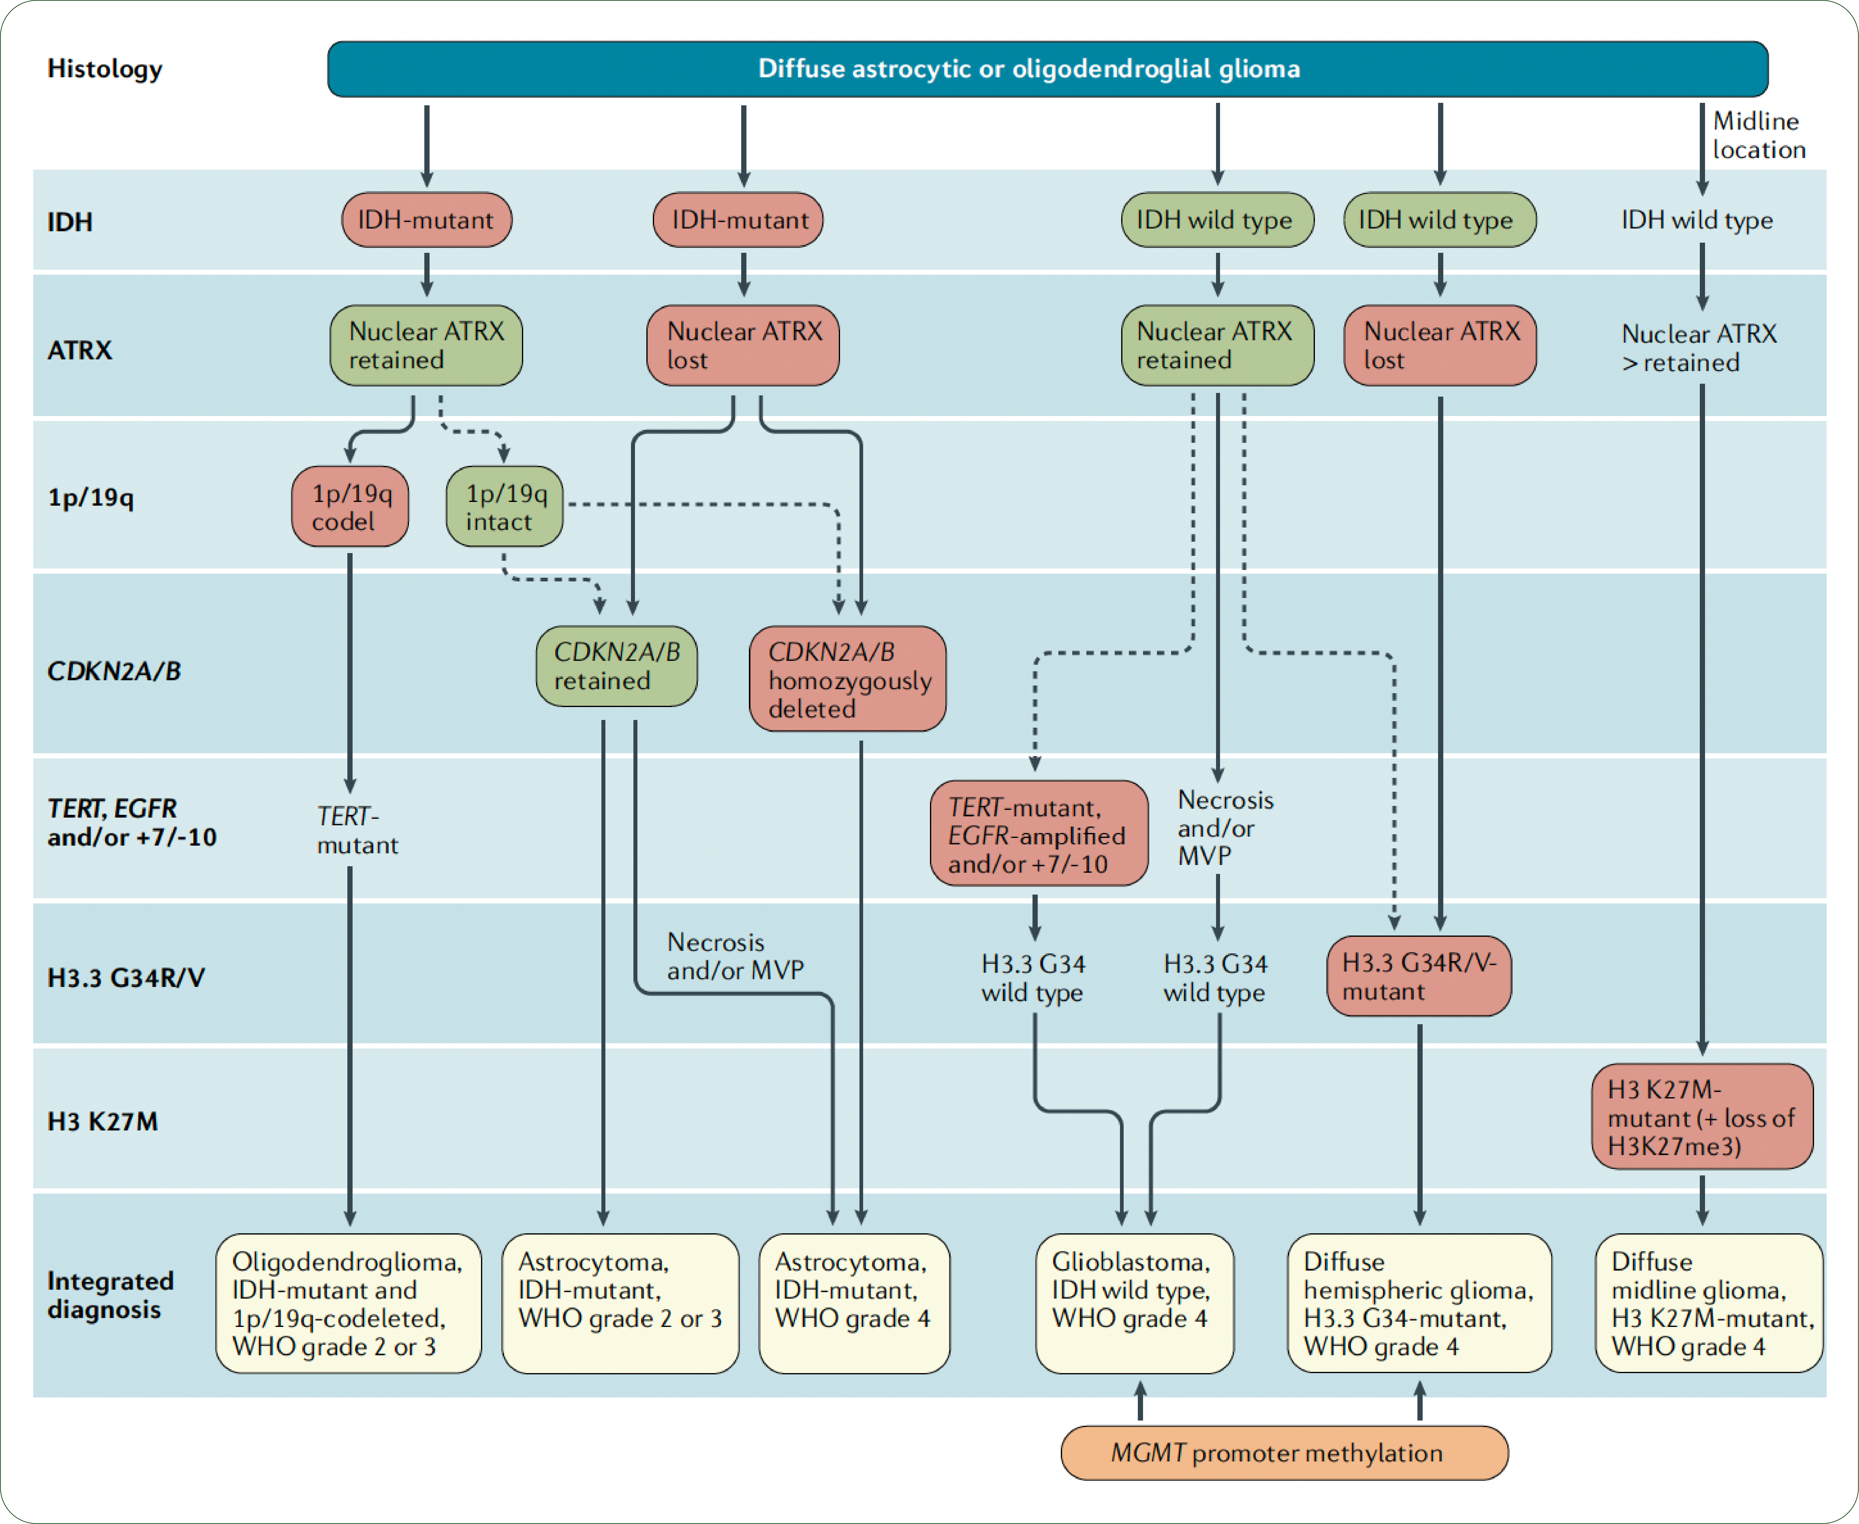
The 7-layer approach to classification of gliomas
Notes:
At the bare minimum, current classification relies on a 7 layer classification approach to query several genes – helping classify diffuse lesions of higher grade

Slide 31
WHO 5th edition changes re: diffuse gliomas
Adult-type diffuse gliomas
  Astrocytoma, IDH-mutant, CNS WHO grades 2, 3, 4
  Oligodendroglioma, IDH-mutant and 1p/19q co-deleted, CNS WHO grades 2, 3
  Glioblastoma, CNS WHO Grade 4 (IDH WT)
Notes:
Main changes in the 5th edition (2021)
The 5th edition (2021) builds on the prior version by placing greater emphasis on molecular markers both in terms of classification and grading and incorporates most of the recommendations made in the cIMPACT-NOW publications ⁶. This approach, however, results in a fairly heterogeneous classification depending on the specific entity. At one end of the spectrum, some tumors remain primarily assessed histologically while at the other end, some are assessed entirely on the basis of molecular parameters.
This will be reflected in a "layered report structure" wherein histological features, grading and molecular information will be combined to form an integrated diagnosis.
integrated diagnosis
histopathological classification
CNS WHO grade
molecular information
Some important changes to terminology and specific entities are worth highlighting.

Slide 32
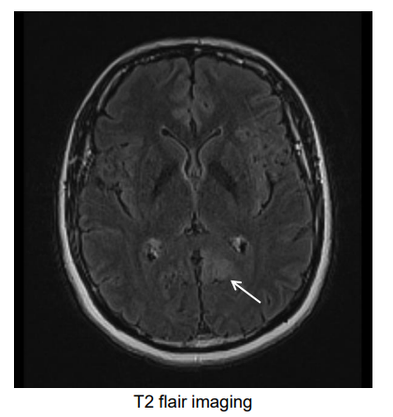
Case #2
44 year-old female presents with new onset seizure
History of chronic frontal headaches for years with no recent change in quality or severity – No other neurologic symptoms
Full workup
Ill defined mass - Left parietal lobe and left parieto-occipital region 2.3 x 2.0 x 1.8 cm mass with effacement of sulcus. No mass effect, midline shift or extra-axial collection.

Slide 33
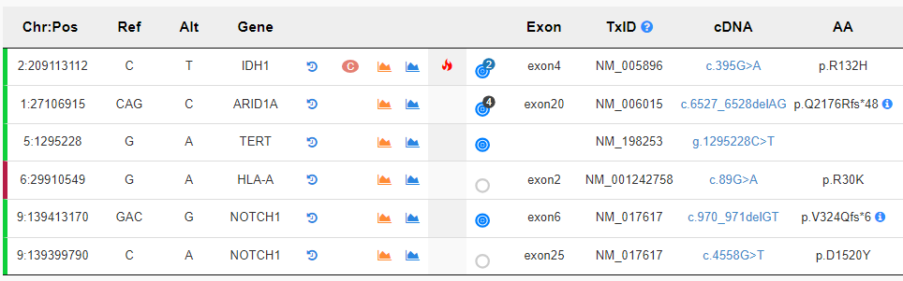
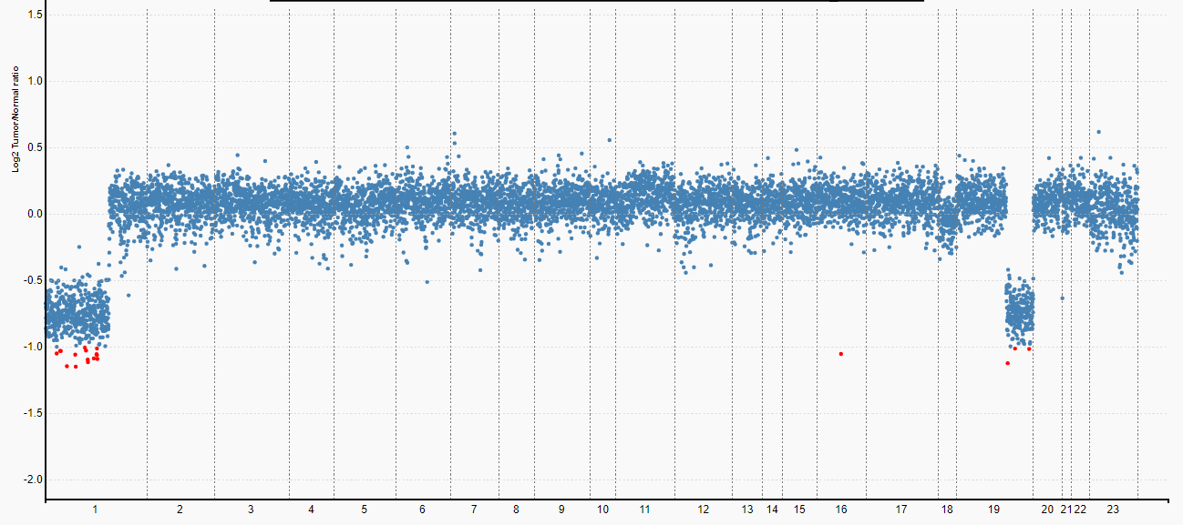
Surgical sample submitted for testing
Codeletion of 1p and 19q
Oligodendroglioma

Slide 34
IDH1/IDH2 mutations in gliomas
Present in majority of WHO grade II gliomas
Likely one of the earlier genetic alterations occurring during development of glioma
Favorable prognosis with significantly longer OS compared to IDH wildtype
Predictive biomarker for chemotherapy benefit

Slide 35
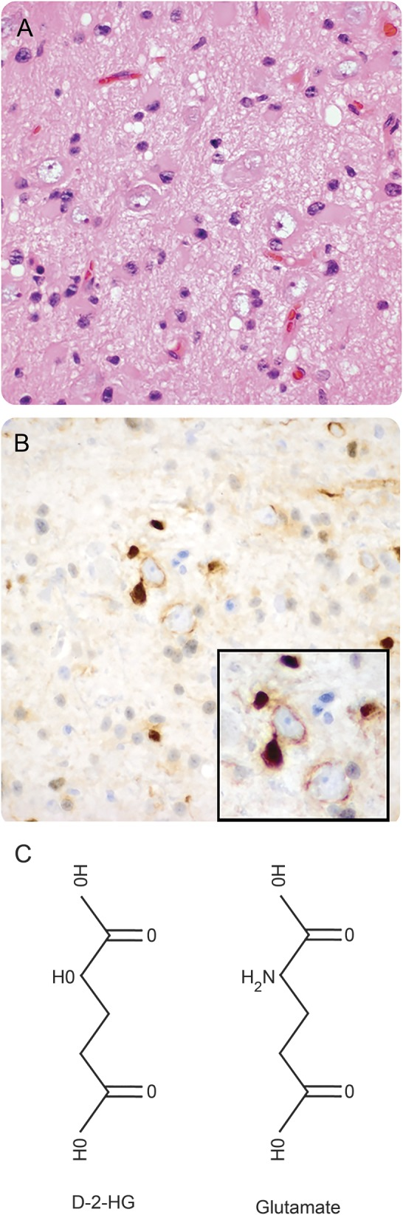
Implications of abnormal IDH function
IDH1 R132H
Accumulation of 2-hydroxyglutarate
Structural resemblance to glutamate, a key excitatory neurotransmitter
Stimulates N-methyl-D-aspartate (NMDA) receptors - susceptibility to seizures
High prevalence of seizures in diffuse gliomas with IDH mutations, such as astrocytomas and oligodendrogliomas.
Tumor cells wrap their processes around neurons
Neurology. 2017 May 9; 88(19): 1805–1813.
Notes:
Chemical structure of d-2-hydroxyglutarate (D2HG) and the close relationship of mutations in isocitrate dehydrogenase 1 (IDH1^{mut}) glioma cells to neurons(A) Hematoxylin & eosin section of the left frontal cortex from a 34-year-old man who presented with seizures shows scattered infiltrative oligodendroglioma cells that were highlighted by R132H IDH1 immunohistochemistry (B). Many tumor cells were closely apposed to neurons, even wrapping their processes around the neurons (B, inset). (C) The chemical structure of D2HG, compared with the structure of the excitatory neurotransmitter, glutamate.

Slide 36
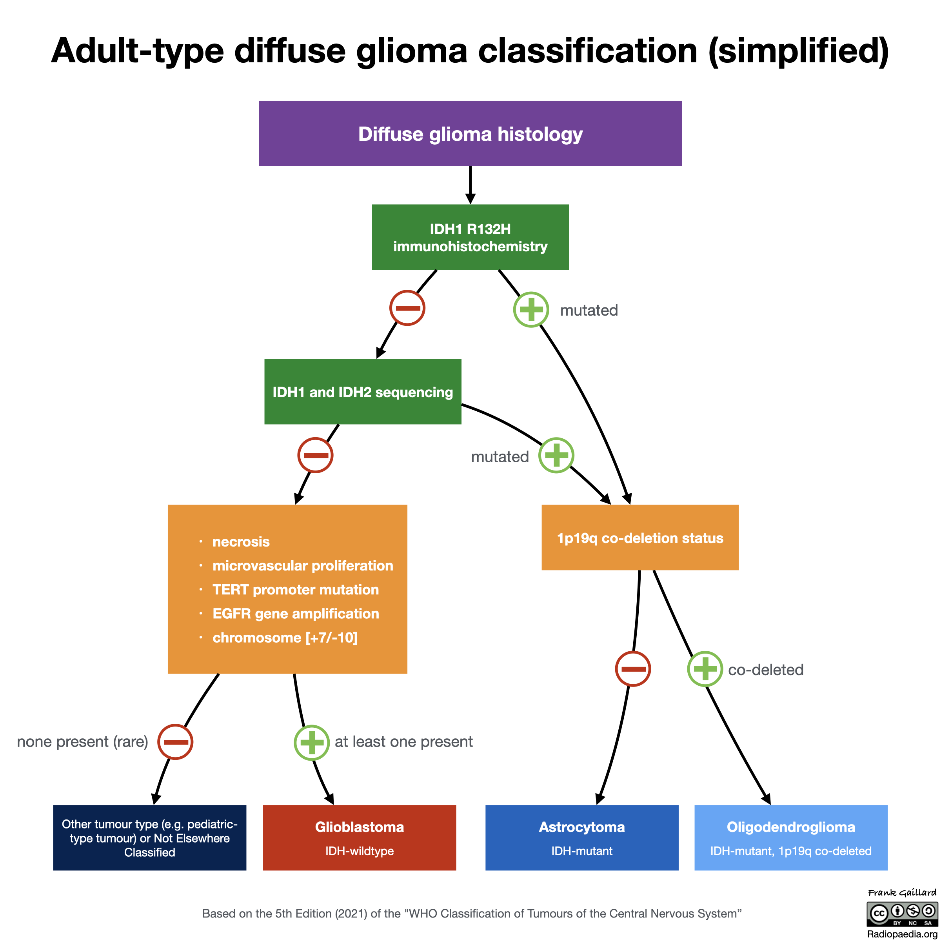
(>85%) of mutations are
IDH1 R132H
Courtesy of Frank Gaillard,
Radiopaedia.org, rID: 94212
Notes:
https://radiopaedia.org/articles/isocitrate-dehydrogenase-idh-1
Which of the following metabolites accumulates in patients with isocitrate dehydrogenase (IDH) mutations and results in an increased likelihood of seizures?
2-hydroxyglutarate yes
α-ketoglutarate
glutamate
glutamine
N-methyl-D-aspartate
A 65-year-old patient with an astrocytic tumor with necrosis is biopsied and the tumor is shown to be IDH1 R132H negative on immunohistochemistry. What is the likelihood that they harbor an alternative IDH1 or IDH2 mutation?
<1% — yes
5-10%
15-25%
30-50%
60-80%
Explanation
IDH1 R132H is the most common, but by no means the only IDH mutation. In individuals older than 55-years-of-age who do not have a known pre-existing low-grade glioma, the probability that they harbor a non-IDH1 R132H mutation of IDH1 or of IDH2 is less than 1%. As such, it is felt reasonable to not pursue sequencing in older patients with R132H negative grade 4 astrocytic tuomours, as the yield is very low.
A 40-year-old male, with no prior history of a brain tumor, undergoes resection of a heterogeneous left frontal lobe tumor. Histology demonstrates an astrocytic tumor with necrosis and microvascular proliferation. Immunohistochemistry confirms astrocytic differentiation and is negative for IDH1 R132H mutations. How should this tumor be classified?
additional tests are required yes
astrocytoma grade 4 IDH mutant
astrocytoma grade 4 IDH wild-type
glioblastoma IDH mutant
glioblastoma IDH wild-type
The presence of necrosis in an astrocytic tumor is sufficient to make it a grade 4 tumor.
The issue is with IDH status. Although IDH1 R132H is the most common, but by no means the only IDH mutation, in this age group, there is a reasonable chance (5-10%) that they harbor a non-IDH1 R132H mutation and before the tumor can be adequately classified according to the 2021 WHO classification of CNS tumors IDH needs to be sequenced to exclude an alternative IDH1 or IDH2 mutation.
Note, if this tumor was shown to have a non R132H IDH mutation, it would be an astrocytoma grade 4, whereas if it was IDH-wildtype it would be a glioblastoma.
Historically, secondary glioblastomas were considered...
far more common than primary glioblastomas
usually IDH mutant
more aggressive than primary glioblastomas
most often found in the temporal lobes
usually diagnosed in older individuals
Which of the following is a good prognostic factor for glioblastoma (GBM)?
extensive necrosis
IDH wild-type (not mutated)
lower ECOG performance status
MGMT methylated (inactive) yes
older age (>70 years of age)
Explanation
MGMT methylation (inactivity) makes tumors more susceptible to alkylating agents (e.g. temozolomide) and therefore a better prognosis. All the others are negative prognostic factors.
Note: as of the 2021 WHO classification of CNS tumors, all glioblastomas are IDH-wildtype. An astrocytic tumor with IDH mutation and necrosis would be considered a grade 4 astrocytoma IDH-mutatnt.
All other things being equal, which of the following biomarkers confers the poorest prognosis in diffuse gliomas?
1p19q co-deleted
ATRX not mutated (intact)
IDH-1 not mutated (wild-type)
MGMT methylated (low activity)
topoisomerase index = 5%
Explanation
IDH-1 wild-type, those that are not mutated, have a prognosis similar to glioblastoma, whereas all the other options are generally good prognostic factors.

Slide 37
Prognostic implications
Diffusely infiltrating gliomas IDHmut - favorable prognosis with significantly longer OS compared to IDHwildtype
Predictive biomarker for chemotherapy benefit
N Engl J Med. 2015 Jun 25;372(26):2481-98.

Slide 38
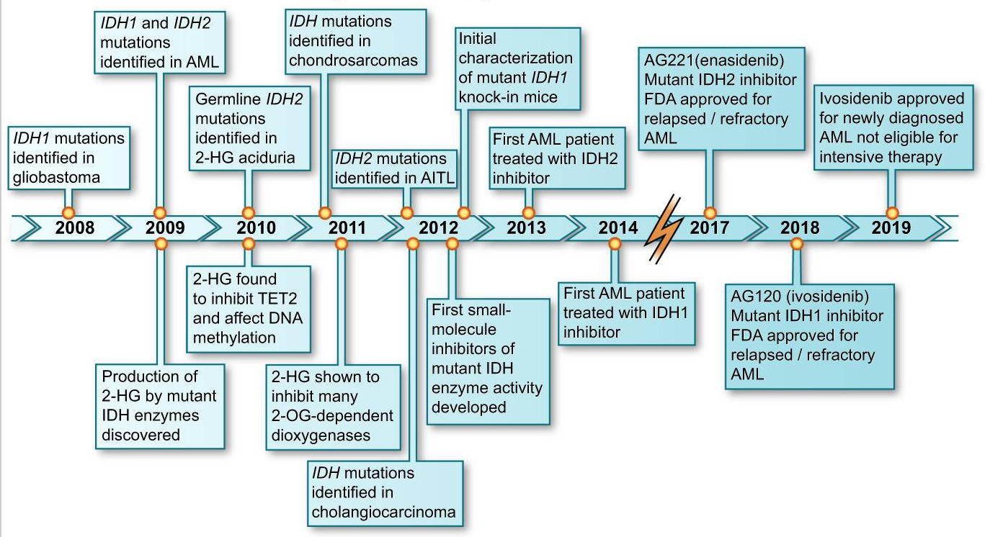
Phase 3 clinical trial of people with low-grade (grade 2) gliomas containing an IDH mutation, vorasidenib significantly slowed tumor growth ….
Issa GC, DiNardo CD. Acute myeloid leukemia with IDH1 and IDH2 mutations: 2021 treatment algorithm. Blood Cancer J. 2021 Jun 3;11(6):107. doi: 10.1038/s41408-021-00497-1. PMID: 34083508; PMCID: PMC8175383.
Notes:
FDA granted a fast-track designation for vorasidenib in March.

Slide 39
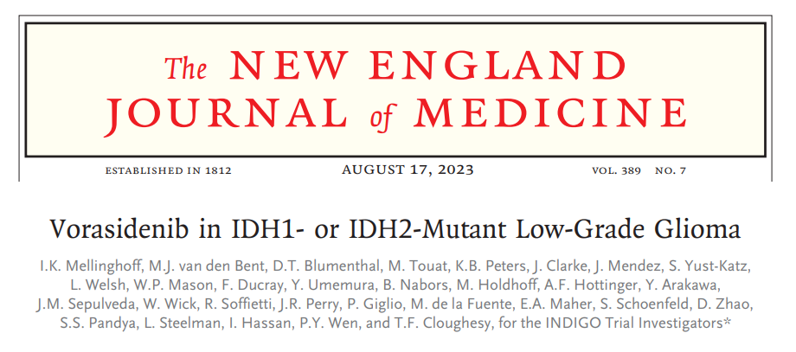
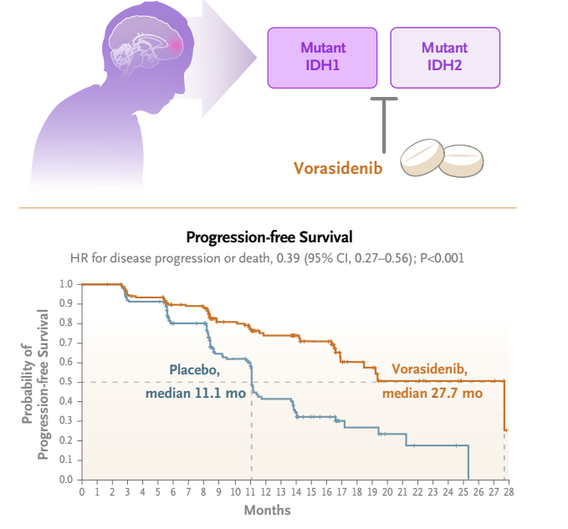
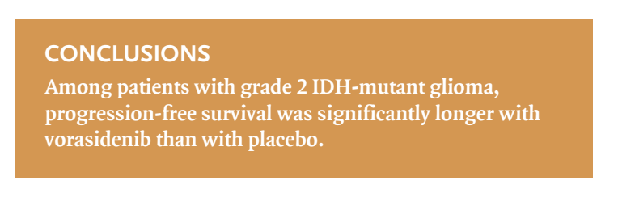

Slide 40
IDH mutations also define other malignancies
Entity | Patient responses to mutant IDH inhibitors vary between tumor types Hematological malignancies exquisitely sensitive to mutant IDH inhibitors Gliomas generally lack pronounced treatment responses
Central chondrosarcoma
Central and periosteal chondromas
Intracranial chondrosarcomas
Angioimmunoblastic T cell lymphoma
Cholangiocarcinoma
Thyroid carcinoma
Breast cancer subtype - Solid papillary carcinoma with reverse polarity
Notes:
IDH mutations also define central chondrosarcoma, central and periosteal chondromas, and intracranial chondrosarcoma and have been identified in angioimmunoblastic T cell lymphoma, cholangiocarcinoma, and thyroid carcinomas and as a hallmark of a unique subtype of breast cancer known as solid papillary carcinoma with reverse polarity
In the last decade, recurrent heterozygous hotspot mutations in the arginine residues of the isocitrate dehydrogenase 1 and −2 (IDH1 and IDH2) genes (p.R132 and p.R140/p.R172, respectively) were identified in enchondroma (87%), central conventional chondrosarcoma (~50%), and dedifferentiated chondrosarcoma (>80%) [7,8,9,10]. The high frequency of IDH1 and IDH2 (collectively referred to as IDH) mutations in benign cartilage tumours indicates that these mutations occur early in tumourigenesis, suggesting that IDH mutations have an important driver role in the formation of cartilage tumours.

Slide 41
IDH mutations in cartilage-producing tumors
High occurrence of IDH mutations in all cartilage producing tumors, including benign
Important role in driving tumorigenesis in early stages
Prognostic value & therapeutic potential not defined
Direct inhibition of IDH^{MUT} proteins seems less promising
Central conventional chondrosarcoma | (~50%)
Dedifferentiated chondrosarcoma | (>80%)
Enchondroma | (87%)
Notes:
The influence of co-occurring (epi)genetic alterations may also explain why distinct IDH^{MUT} tumour types differ in therapy sensitivity and underlines the need to use endogenous IDH^{MUT} models, as generic cancer cell lines with an introduced IDH mutation do not represent the (epi)genetic landscape in which IDH mutations naturally exist. Thus, the IDH mutation status does not solely define the underlying vulnerabilities, which is in line with previous findings for chondrosarcoma [61,62,63,64,65,66,67], suggesting that a dichotomy between IDH^{WT} and IDH^{MUT} is too simplistic.

Slide 42
 | AML | Glioma | Cholangiocarcinoma | Chondrosarcoma
Frequency of IDH^{MUT} | ~10–15% [14] | >70% [14] | ~15–20% [14] | ~50% [7,8,9]
Most common IDH^{MUT} variant | IDH2 p.R140Q (~40%) Weak D-2-HG Producer [16,17] | IDH1 p.R132H (~90%) Weak D-2-HG Producer [16,18] | IDH1 p.R132C (~60%) Strong D-2-HG Producer [16,18] | IDH1 p.R132C (~60%) Strong D-2-HG Producer [15,16,18]
IDH^{MUT} inhibition in vitro | Differentiation [26] | No effect [27] | No effect [28] | Controversial [27,29,30,31]
IDH^{MUT} inhibition clinical trials | ~40% response, secondary resistance [32,33,34,35] | Less promising, prolonged disease control in subset [36] | Less promising, prolonged disease control in subset [37] | Durable disease control in subset [38]
IDH^{MUT} effect on outcome | No difference (in MDS: worse prognosis) [20,21] | Better prognosis, due to favourable response? [22] | Beneficial? [23] | Controversial [15,24,25]
Cancers (Basel). 2023 Jul; 15(14): 3603.

Slide 43
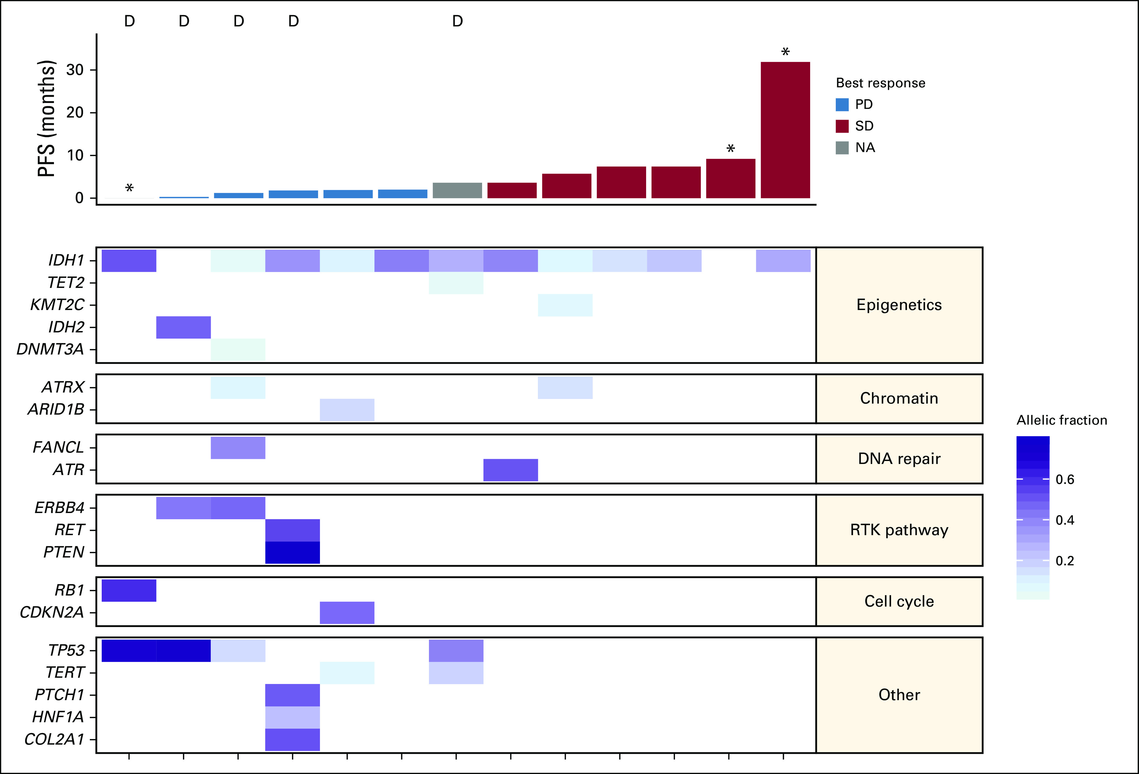
Some key aspects of IDH mutated chondrosarcomas
Best response to Ivosidenib observed in chondrosarcoma with a minimal number of co-occurring mutations
Highly heterogeneous genetic landscape
Develop additional mutations in late stages - may hamper the efficacy of IDH inhibitors
Some become independent of IDH over time and additional mutations take over the driver role
Characterized by a global hypermethylation phenotype that changes with increasing histological grade
J Clin Oncol. 2020 May 20; 38(15): 1693–1701

Slide 44
Given some of the limited efficacy of IDH inhibitors in-vitro and clinical trials or acquired resistance
In-vitro studies have explored whether directly targeting the downstream biological effects of IDH mutations would be more promising – take advantage of underlying vulnerabilities of the cells
Mixed results, some contradictory
Notes:
As IDH^{MUT} protein inhibitors showed limited efficacy in in vitro assays and clinical trials or acquired resistance was observed (Table 1), a large number of in vitro studies were performed to determine whether directly targeting the downstream biological effects of IDH mutations would be more promising (Table 2). Indeed, multiple synthetic lethal interactions with the IDH mutation were reported for AML and glioma, including radiotherapy, chemotherapy, and agents that target poly(ADP-ribose) polymerase (PARP), B-cell lymphoma 2 (Bcl-2) family members, Bromodomain and Extra-Terminal Motif (BET) proteins, DNA methyltransferases (DNMTs), mTOR, Nicotinamide Phosphoribosyltransferase (NAMPT), and glutaminase

Slide 45
Synthetic lethal interactions of mutant IDH compromise
Invitro-models – aim to take advantage of
 | AML | Glioma | Cholangiocarcinoma | Chondrosarcoma
Radiotherapy | Molenaar 2018 [47] * | Li 2013 [48] Kessler 2015 [49] |  | De Jong 2019 [61] *
Temozolomide |  | Lu 2017 [50] Tateishi 2017 [51] * |  | Venneker 2019 [66] *
PARP inh. | Sulkowski 2017 [52] Molenaar 2018 [47] * | Sulkowski 2017 [52] | Wang 2020 [53] | Venneker 2019 [66] * Palubeckaitė [67] *
Bcl-2/Bcl-xL inh. | Chan 2015 [54] | Karpel-Massler 2017 [55] |  | De Jong 2018 [62] *
BET inh. | Chen 2013 [56] | Fujiwara 2018 [28] | Fujiwara 2018 [28] *
DNMT inh. |  | Turcan 2013 [57] *
mTOR inh. |  | Batsios 2019 [58] |  | Addie 2019 [63] *
NAMPT inh. |  | Tateishi 2015 [27] * |  | Peterse 2017 [64] *
Glutaminolysis inh. | Emadi 2014 [59] * | Seltzer 2010 [60] |  | Peterse 2018 [65] *
Cancers (Basel). 2023 Jul; 15(14): 3603.
Synthetic lethal interactions with the IDH mutation in in vitro models.
inh.: inhibitors, * endogenous IDH^{MUT} models. Green: Sensitive; Red: Not sensitive; Yellow: Sensitive, but irrespective of IDH^{MUT}.
Notes:
To enhance the antitumor effect of IDH mutant inhibitors, a series of preclinical studies investigated synthetic lethal interactions of mutant IDH compromise

Slide 46
Highlights
Cell of origin and the tumor microenvironment in distinct tumor types makes a difference
Level of the D-2-HG oncometabolite may also influence the downstream biological effects of IDH mutations.
  Most common IDH variants in AML and glioma produce comparatively low D-2-HG levels compared to those in cholangiocarcinoma and chondrosarcoma
  The type of in vitro model (endogenous vs. artificially created) might influence whether synthetic lethal interactions with the IDH mutation are present or not
Dichotomy between IDH^{WT} and IDH^{MUT} may be too simplistic for some disease contexts
Notes:
First, the cell of origin and the tumour microenvironment (e.g., cartilaginous matrix formation and hypoxia in chondrosarcoma) of the distinct tumour types that frequently harbour an IDH mutation are highly different and could therefore influence the role that IDH mutations play in tumourigenesis. Second, the level of the D-2-HG oncometabolite may also influence the downstream biological effects of IDH mutations. The most common IDH variants in AML and glioma both produce relatively low D-2-HG levels, whilst the most common point mutation in both cholangiocarcinoma and chondrosarcoma produces relatively high levels of the oncometabolite (Table 1) [17,18,19]. It was recently shown that a lower level of DNA hypermethylation was observed for the IDH1 p.R132H variant compared to non-p.R132H variants, irrespective of tumour type [16]. Lastly, the type of in vitro model (endogenous vs. artificially created) might influence whether synthetic lethal interactions with the IDH mutation are present or not. The introduction of an IDH mutation in a glioma model leads to reduced glutamine and glutamate levels, but this change in TCA cycle metabolites is not present when endogenous IDH^{WT} and IDH^{MUT} glioma models are compared [68]. Most synthetic lethal interactions with the IDH mutation were indeed identified in generic cancer cell lines with an introduced IDH^{MUT} (Table 2). AML and glioma cell lines with an endogenous IDH^{MUT} are scarce, but the utilised chondrosarcoma cell lines do harbour endogenous IDH mutations and this difference in model type could explain why synthetic lethal interactions with the IDH mutation are absent in the chondrosarcoma in vitro studies. As IDH mutations occur early during tumourigenesis, especially in chondrosarcoma, artificial models with an introduced IDH mutation may not be representative of the role that IDH mutations normally play in tumourigenesis. These studies also introduced the IDH mutation in generic cancer cell lines that are easy to transfect (e.g., HeLa, HCT116, and U2OS cells), and these cell lines do not represent the tumour types in which IDH mutations frequently occur. Moreover, most studies generated models that overexpressed the IDH^{MUT} protein, whilst the balanced expression of IDH^{WT} and IDH^{MUT} is needed to retain efficient D-2-HG production [69]. Together, these considerations emphasise that the tumour type, the IDH^{MUT} variant, and the type of in vitro model should be taken into account when studying synthetic lethal interactions with the IDH mutation, and that the underlying vulnerabilities may highly differ between tumour types that frequently harbour an IDH mutation.

Slide 47
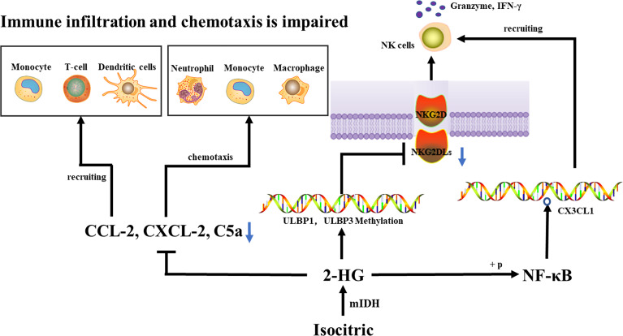
Suppression of the tumor-associated immune system
Has emerged as one of the latest effects caused by the expression of mutant IDHs
Tumor escapes immune surveillance
2HG inhibits the tumor-associated immune system
Inhibits NK cell activation
Inhibits Classical and Alternative Complement Pathways
Potential opportunity for immunotherapy drugs and ?? IDH specific vaccines
Front Immunol. 2022; 13: 914618.
Notes:
Among the many biological phenotypes caused by expression of mutant IDHs, the suppression of the tumor-associated immune system emerged as one of the latest and probably most intriguing examples. The exploration of IDHs will undoubtedly continue to establish IDH mutation as an important event in the genesis and progression of a wide spectrum of systemic and solid cancers and will unravel novel and unexpected functions of nonmutated IDHs in human disease. Below, we discuss some of the most critical questions.
An IDH1 mutation lowers the expression of CCL-2, CXCL-2, and C5a, which reduces immune cell recruitment and chemotaxis, thus inhibiting the tumor-associated immune system. IDH mutations cause hypermethylation of the ULBP1 and ULBP3 promoters, as well as a decrease in NKG2DL, which affects NKG2DL-NKG2D interaction, inhibits NK cell activation, and ultimately escapes immune surveillance by NK cells. 2-
Inhibit tumor evasion
IDH mutations in gliomas can prevent tumors from evading the immune system's NK cell surveillance.
Suppress leukocyte chemotaxis
IDH1 mutations can cause leukocyte chemotaxis to decrease, which can repress the tumor-associated immune system.
Reduce PD-L1 expression
Reduced PD-L1 expression in IDH-mutated gliomas can lead to stronger T cell activation. PD-L1 is a protein on the surface of cells that suppresses T cell activity and promotes self-tolerance.
Release a metabolite
Cancer cells with IDH mutations can release a metabolite that can disable nearby T cells.
Inhibit complement pathways
Mutant IDH can inhibit both classical and alternative complement pathways.
Inhibit T-cell responses
Mutant IDH can directly inhibit T-cell responses by metabolizing isocitrate to D-2-Hydroxyglutaric acid.

Slide 48
Take Home Points
Isocitrate dehydrogenases (IDHs) are critical metabolic enzymes that epigenetically control expression
Deregulation through mutation is seen in many human cancers
Tumors with mutated IDH lead to accumulation of 2HG, an oncometabolite with a multifaceted activity profile
IDH inhibitors have been created, aiming to reverse the pathologic effects of mutated IDH.
Prognostic implications of mutation and therapeutic responses to IDH inhibitors vary widely across tumor types, suggesting highly complex biology

